Slide 1


Tunneling Phenomena in Ultra-Thin Oxide MOS Structures
Neelanjan Goswami
400414867
McMaster UNIVERSITY
Faculty Advisor:
Dr. Yaser Haddara
Department of Electrical and Computer Engineering
McMaster University

Slide 2
Contents
Introduction
Direct Tunneling
Fowler-Nordheim Tunneling
Modeling Assumptions
Dependencies and Approximations
Circuit Simulations
Components of tunneling currents
Potential Barrier Lowering Through Image Forces
Compact MOS Models: Understanding and Analyzing Gate Current
Consequences of Gate Tunneling Current on Device Performance
Conclusion
References

Slide 3
Introduction
Semiconductor devices have transformed electronics and opened up new opportunities for growth in several sectors, including computing, telecommunications, energy, and healthcare. They are a crucial component of numerous devices that are necessary for modern living.
MOS structures have attracted a lot of interest in the electronics industry because of its special qualities, which include high electron mobility and low power consumption. In the contemporary digital era, when there is an increasing need for small and power-efficient electronic equipment, they are especially pertinent.
This talk aims to give a thorough understanding of the tunneling phenomenon in ultra-thin oxide MOS systems. Understanding this quantum mechanical phenomenon is essential for the further advancement of electronic devices, since it can have a substantial impact on the performance of MOS structures.
Notes:
Semiconductor devices, the backbone of modern electronics, have revolutionized various sectors like computing, telecommunications, energy, and healthcare. MOS structures, in particular, stand out for their high electron mobility and low power consumption, making them vital in the contemporary digital landscape. As our reliance on small and power-efficient electronic devices grows, MOS structures become increasingly relevant.
Today, we delve into the intricate world of tunneling phenomena in ultra-thin oxide MOS systems. This quantum mechanical phenomenon is pivotal for the advancement of electronic devices, as it significantly influences the performance of MOS structures. Let's explore the fascinating realm of ultra-thin oxide MOS systems and unveil the insights that drive innovation in electronic technologies.

Slide 4
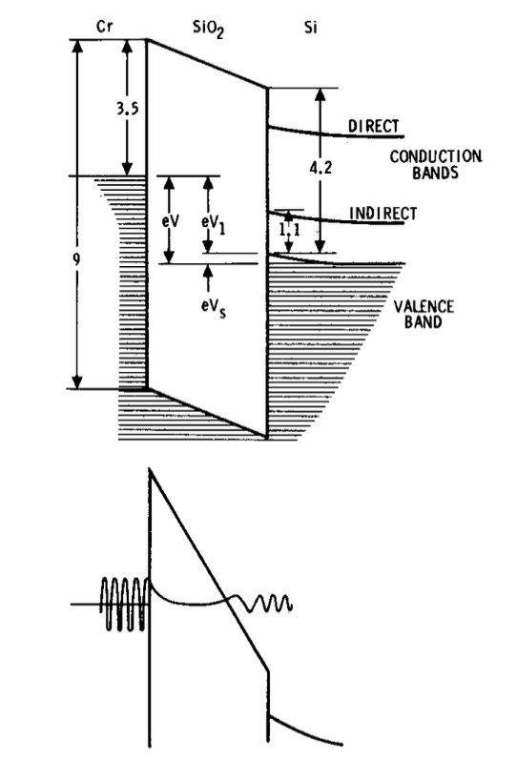
Introduction
Figure 1. A thin MOS structure band model. The Fowler-Nordheim tunneling is depicted in the lower diagram. [2]
Notes:
Figure 1 presents a band model for a thin MOS structure, showcasing Fowler-Nordheim tunneling in the lower diagram. Recent findings on tunneling through thin MOS structures reveal a surprisingly well-defined chemical and electronic structure. Despite common skepticism regarding one-dimensional band models applied to extremely thin amorphous oxide layers, our study, focusing on Au/Cr/Si02/Si structures with oxide films in the 20-40 A thickness range, aligns with the ideal model.
Contrary to arguments about molecular layer uncertainty and nonuniformity in amorphous material, our MOS structures behave as predicted by the one-dimensional model. The tunneling characteristics are interpreted in four voltage regions, elucidated by Figure 1:
At low fields (V < 1.1 V), inelastic tunneling into surface states occurs.
With V exceeding 1.1 V, inelastic tunneling continues into the indirect conduction band of silicon, leading to a rapid increase in current.
When V1 surpasses 3.4 V, elastic tunneling occurs into the direct conduction band of silicon.
At high fields (V1 > 4.2 V), Fowler-Nordheim tunneling into the oxide conduction band is observed.
Analyzing results posed challenges, particularly in understanding the current-voltage dependence for inelastic tunneling (regions I and II) and defining the dispersion relation k(E) for electron wave attenuation in the oxide band gap. Research by Lewicki and others demonstrates that k(E) can be measured for MIM structures with trapezoidal energy barriers, offering valuable insights into tunneling mechanisms.

Slide 5
Introduction
Si MOSFET prototypes [1] with gate lengths significantly less than 20 nm are the product of ongoing advancements in Si nanotechnology. The importance of quantum processes like size quantization and gate oxide tunneling increases with decreasing channel lengths.
Conventional CMOS transistors reach their limits when dimensions and operating voltages decrease, propelling ongoing technological progress. Modern CMOS technology emphasizes how crucial gate oxide layer thickness: 1.2 - 1.5nm for channel lengths shorter than 100 nm [1].
A thorough grasp of contemporary semiconductor technologies is crucial because gate leakage current, particularly through edge direct tunneling (EDT), greatly affects off-state leakage and stability in Very Large Scale Integration (VLSI) circuits in ultra thin gate oxide domains.
Notes:
The development of Si MOSFET prototypes with gate lengths below 20 nm is a testament to ongoing advancements in Si nanotechnology. As channel lengths decrease, the significance of quantum processes such as size quantization and gate oxide tunneling becomes more pronounced.
Conventional CMOS transistors face limitations as dimensions and operating voltages decrease, driving continuous technological advancements. In modern CMOS technology, the gate oxide layer thickness, especially in the range of 1.2 - 1.5 nm for channel lengths shorter than 100 nm, plays a critical role.
Understanding contemporary semiconductor technologies is essential, given that gate leakage current, particularly through edge direct tunneling (EDT), significantly impacts off-state leakage and stability in Very Large Scale Integration (VLSI) circuits, especially in ultra-thin gate oxide domains.

Slide 6
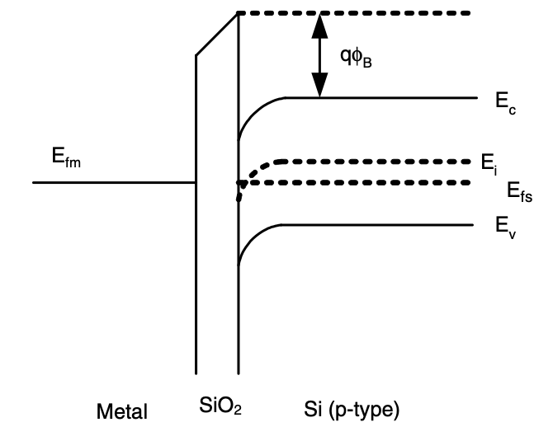
Direct Tunneling
Figure 2. Band diagram for a structure consisting of metal, oxide, and semiconductor without any applied voltage; the oxide fixed charges and the difference in the work function of the metal and semiconductor create the band bending. The conduction band is denoted by Ec, intrinsic Fermi level by Ei, semiconductor Fermi level by Efs, and metal Fermi level by Efm. [1]
Notes:
This band diagram illustrates the structure of metal, oxide, and semiconductor without any applied voltage. The oxide fixed charges and the difference in the work function of the metal and semiconductor create band bending. Here's a breakdown of the components:
Metal–Oxide–Semiconductor Structure:
Metal (M)
Oxide (O)
Semiconductor (S)
Key Features:
Band Bending: Created by oxide fixed charges and the work function difference.
Conduction Band (Ec)
Intrinsic Fermi Level (Ei)
Semiconductor Fermi Level (Efs)
Metal Fermi Level (Efm)
Band Diagram (Fig. 2):
Metal–Oxide–p-type Semiconductor
No Applied Voltage
Negative Work Function Difference (e.g., MOS device with Al gate on Si substrate)
Effect of Applied Voltage:
When a large positive voltage is applied to the metal relative to the substrate:
Left-hand side of the band diagram is lowered.
Electron tunneling from the semiconductor's conduction band into the oxide's conduction band is facilitated.

Slide 7
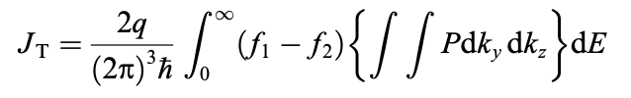
Direct Tunneling
Under strong applied fields, tunneling currents were seen in early MOS devices, which resulted in a decrease in one side of the potential barrier at the SiO2 interface. Since thick oxides (about 70–1000 Å) were utilized, it is unlikely that direct tunneling into the conduction band of the opposite electrode will occur.
However, direct tunneling at lower fields becomes substantial when the oxide thickness is decreased to a few nanometers, producing an approximately trapezoidal barrier (Fig. 3(b)).
The probability of tunneling entails the integration of wave vectors, electron energy, and state probabilities on both sides of the barrier. The effective mass approximation and the Fermi-Dirac distribution functions are crucial for determining the current-voltage relationship:
a
Notes:
In the early days of MOS devices, strong applied fields led to tunneling currents, causing a reduction in one side of the potential barrier at the SiO2 interface. At that time, thick oxides (around 70–1000 Å) were in use, making direct tunneling into the conduction band of the opposite electrode unlikely.
As technology progressed and oxide thickness was reduced to a few nanometers, direct tunneling at lower fields became significant, resulting in the formation of an approximately trapezoidal barrier (refer to Fig. 3(b)).
The probability of tunneling involves the integration of wave vectors, electron energy, and state probabilities on both sides of the barrier. The effective mass approximation and the Fermi-Dirac distribution functions play a crucial role in determining the current-voltage relationship.
where P is the tunneling probability, E is the total electron energy, ky and kz are the wave vectors in the plane of the barrier (perpendicular to the tunneling direction), and f1 and f2 are the probabilities of occupation of the states on each side of the barrier, given by the Fermi–Dirac distribution functions; the integration limits for ky and kz are determined from momentum and energy conservation.

Slide 8
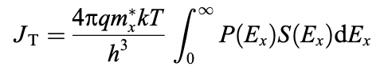
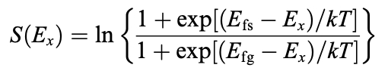
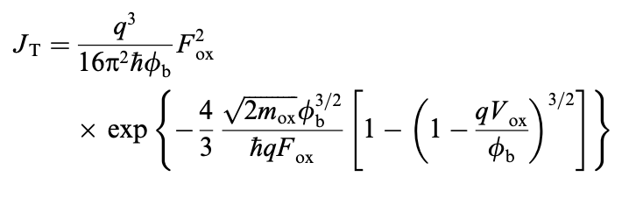
Direct Tunneling
By integrating the Fermi–Dirac distribution function and assuming that an electron can have a single effective mass in each of the three zones, the following results are obtained:
,where:
Determining tunneling current involves solving Schroedinger's equation for electron wave function, considering periodic lattice potential and applying approximations like the Wentzel–Kramers–Brillouin or neglecting Fermi–Dirac functions for modeling, with an alternative expression to address limitations:
Notes:
To determine tunneling current, we integrate the Fermi–Dirac distribution function, assuming that an electron can have a single effective mass in each of the three zones. The results are expressed as follows:
�∝�⋅�⋅�∗⋅�ℏ⋅exp⁡(−2��ℏ)J∝ℏq⋅E⋅m∗⋅T​⋅exp(−ℏ2κd​)
Where:
�J is the tunneling current.
�q is the elementary charge.
�E is the electric field.
�∗m∗ is the effective mass.
�T is the tunneling probability.
Determining tunneling current involves solving Schroedinger's equation for the electron wave function, considering periodic lattice potential. Approximations like the Wentzel–Kramers–Brillouin method or neglecting Fermi–Dirac functions for modeling are applied. An alternative expression is used to address limitations.
where h is Planck’s constant, mx is the electron effective mass in the direction perpendicular to the barrier, Ex is the electron kinetic energy in the direction perpendicular to the barrier, k is the Boltzmann constant, T is the temper- ature, and S(Ex) is the ‘‘supply’’ function, which is derived from the integration of the Fermi–Dirac distribution func- tion, and is given by [3]:
where Efs and Efg are the electron Fermi levels in the semi-
conductor and the gate, respectively. Note that the applied voltage is implicitly present in this equation through the difference between the Fermi levels. Finding the probability of tunneling through the barrier and solving the integral then becomes the only task left to determine the tunneling current. Schroedinger's equation for the electron wave function must be solved to get the tunneling probability. assuming the electron is free and including the effect of the periodic lattice potential through the use of the effective mass. f the potential is not constant, but it changes ‘‘slowly’’ with position, This is known as the Wentzel–Kramers–Brillouin (WKB) approximation. The condition of a ‘‘slow’’ change of the potential means that the changes in the potential and its derivative on each electron wavelength, should be small compared to the energy of the particle. Another possible approximation is to neglect the effect of the finite availability of carriers for tunneling, given in (3) by the presence of the Fermi–Dirac functions, by assuming a degenerate inversion or accumulation layer in the semiconductor surface This can be used to model the tunneling current for moderate applied bias, where there is strong inversion or accumulation, but the field is not high enough to cause Fowler–Nordheim tunneling. However, for low voltages, where there is a limited availability of carriers for tunnel- ing, this expression can overestimate the tunneling current by several orders of magnitude as shown in Fig. 8; besides, in (13) the current does not go to zero for zero field, which is to be expected from basic physics. An alternative expres- sion that overcomes this problem is [30]

Slide 9
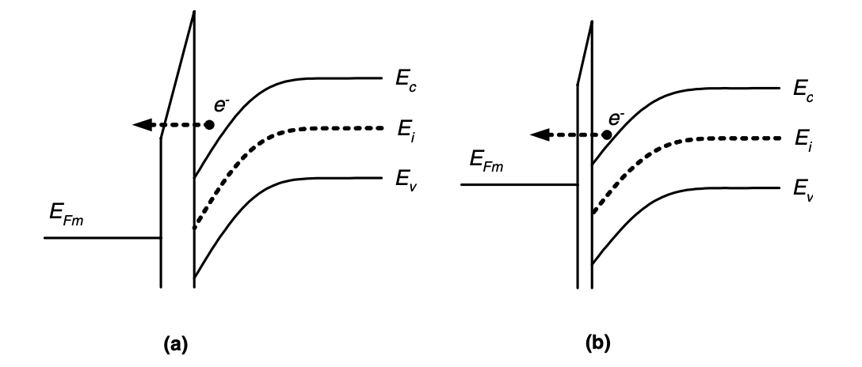
Fowler-Nordheim Tunneling
Figure 3. (a) Tunneling through a triangular barrier into the insulator conduction band (Fowler–Nordheim tunneling). (b) Tunneling through a trapezoidal barrier (direct tunneling). [1]
Notes:
"Figure 3 illustrates two types of tunneling mechanisms: (a) Tunneling through a triangular barrier into the insulator conduction band, known as Fowler–Nordheim tunneling. (b) Tunneling through a trapezoidal barrier, called direct tunneling.
In Fowler–Nordheim tunneling, when a large positive voltage is applied to the metal relative to the substrate, the left-hand side of the band diagram lowers. Electrons can then tunnel through an approximately triangular barrier from the conduction band of the semiconductor into the conduction band of the oxide, as shown in Fig. 3(a).
The current in Fowler–Nordheim tunneling is expressed by a relatively simple formula:
\[ J_{FN} = \frac{q^2 \sqrt{2m_{ox}}}{\hbar} \frac{E_{ox}^2}{\phi_b} \exp\left(-\frac{4\pi\phi_b^{3/2}}{3qE_{ox}}\right) \]
Assumptions for the derivation of this formula include the triangular shape of the potential barrier, neglecting the barrier lowering due to image forces, and describing electrons on the emitting electrode as a free Fermi gas.
In the Fowler–Nordheim tunneling regime, a Fowler–Nordheim plot, plotting the logarithm of \(J_{FN}/E_{ox}^2\) versus \(1/E_{ox}\), yields a straight line, providing a good fit to experimental data for MOS structures with relatively thick oxide and metal gate.” While the Fowler–Nordheim model is effective for some scenarios, modern structures present challenges beyond its simplicity. Here are some factors not adequately addressed by the Fowler–Nordheim model:
Direct Tunneling through Trapezoidal Barriers: For low applied voltages, direct tunneling through an approximately trapezoidal barrier becomes significant.
Carrier Quantization: In the inversion/accumulation layer, carrier quantization effects come into play, impacting tunneling characteristics.
Multiple Tunneling Mechanisms: Beyond conduction band tunneling of electrons, other tunneling mechanisms emerge, including valence band hole tunneling and valence band electron tunneling.
Temperature Effects: The finite temperature introduces complexities in the availability of carriers for tunneling, a factor not considered in the simple Fowler–Nordheim model.
Depletion Effects: The impact of depletion effects on the polysilicon gate is not adequately accounted for in the Fowler–Nordheim model.

Slide 10
Fowler-Nordheim Tunneling
The left side of the band diagram decreases when a significant positive voltage is supplied to the metal in comparison to the substrate. This voltage change creates a roughly triangular barrier by facilitating electron tunneling from the conduction band of the semiconductor into the conduction band of the oxide.
Fowler-Nordheim tunneling is the name given to the tunneling that is described via a potential barrier that is roughly triangular in shape. When a high positive voltage is provided, electrons can tunnel through the triangle barrier, causing this phenomena. A somewhat simple calculation for current as a function of applied voltage captures the simplicity of this tunneling procedure.
Notes:
When a significant positive voltage is applied to the metal compared to the substrate, the left side of the band diagram decreases. This voltage change creates a roughly triangular barrier, facilitating electron tunneling from the conduction band of the semiconductor into the conduction band of the oxide.
This tunneling phenomenon is known as Fowler-Nordheim tunneling, named after the triangular potential barrier it involves. When a high positive voltage is applied, electrons can tunnel through the triangular barrier, leading to this phenomenon. The calculation of current as a function of applied voltage captures the simplicity of this tunneling procedure.

Slide 11
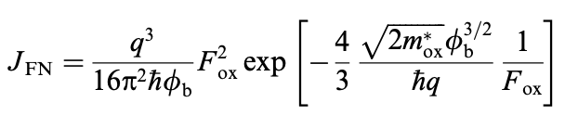
Fowler-Nordheim Tunneling
The MOS device's operation involves a positive metal voltage decreasing the left side of the band diagram, creating a triangular barrier that facilitates electron tunneling from semiconductor to oxide. This technique is crucial for understanding gate tunneling current and the device's functioning.
This gives the following quite straightforward formula that describes the current during Fowler-Nordheim tunneling as a function of applied voltage:
Comprehending the link between current and voltage is essential in order to understand the gate tunneling current in MOS devices, which provides an understanding of their electrical behavior.
Notes:
"The operation of MOS devices hinges on a positive metal voltage, which lowers the left side of the band diagram, forming a triangular barrier. This process facilitates electron tunneling from the semiconductor to the oxide. Understanding this mechanism is pivotal for grasping gate tunneling current and the overall functionality of the device.
The formula for current during Fowler-Nordheim tunneling as a function of applied voltage is straightforward:
\[ J_{FN} = \frac{q^2}{\phi_b}E_{ox}^2 \exp\left(-\frac{4\pi\sqrt{2m_{ox}\phi_b^3}}{3qh}\right) \]
This equation establishes a clear connection between current and voltage, providing crucial insights into the gate tunneling current in MOS devices and, consequently, their electrical behavior."
where q is the electron charge, h is Planck’s reduced con- stant, mox is the electron effective mass in the insulator, /b is the barrier height at the semiconductor–oxide inter- face and Fox is the electric field across the oxide. The assumptions for the derivation of (1) are [8,9]:
The electrons on the emitting electrode can be described as a free Fermi gas.
The dependence of carrier availability for tunneling with respect to temperature is not taken into account.
The potential barrier has triangular shape and barrier lowering due to image forces is neglected.
The effect of the insulator can be described by a single effective mass.
The tunneling probability takes into account only the component of the electron momentum in the direction normal to the surface.

Slide 12
Modeling Assumptions - Direct Tunneling
Electrons can tunnel through an energy level that is conventionally prohibited through the interesting quantum mechanical mechanism of direct tunneling.
Free Fermi Gas: When electrons are considered as a free Fermi gas on the emitting electrode in direct tunneling, they follow the Pauli Exclusion Principle and occupy separate quantum states devoid of interaction.
Temperature Dependence: Remarkably, the temperature dependency of carrier availability for tunneling is not taken into account in direct tunneling modeling. This is thus because, rather than the thermal energy of the system, the tunneling process is mostly dictated by the characteristics of the barrier (height, width, and electron energy).
Potential Barrier: The mathematical analysis of the assumed triangle potential barrier in direct tunneling is made simpler, even if actual barriers may have a more complicated form. It is customary for models to ignore image forces, which are forces that result from an electron interacting with its image charge. These forces can reduce the barrier, but they are typically regarded as insignificant.
Notes:
Direct Tunneling: Electrons exhibit a fascinating quantum mechanical phenomenon known as direct tunneling, allowing them to traverse energy levels conventionally considered inaccessible.
Free Fermi Gas: In the context of direct tunneling, electrons are treated as a free Fermi gas on the emitting electrode, adhering to the Pauli Exclusion Principle. They occupy distinct quantum states without interacting with each other.
Temperature Dependence: Surprisingly, the temperature dependence of carrier availability is not factored into direct tunneling modeling. Unlike many processes influenced by thermal energy, tunneling in this scenario is primarily dictated by barrier characteristics (height, width, and electron energy).
Potential Barrier: Mathematical analysis simplifies the assumed triangular potential barrier in direct tunneling, although actual barriers may have a more complex form. Models often overlook image forces, forces resulting from an electron interacting with its image charge, as they are generally considered insignificant despite their potential to reduce the barrier.

Slide 13
Modeling Assumptions: Fowler - Nordheim Tunneling
In a metal-oxide-semiconductor (MOS) structure, Fowler-Nordheim tunneling, a specific form of direct tunneling, takes place in a strong electric field. This causes the barrier at the metal-oxide interface to thin, allowing electron tunneling.
Wave-Mechanical Tunneling: In Fowler-Nordheim tunneling, a rounded triangle barrier that forms at the surface of an electron conductor under a strong electric field is tunneled by electrons wave-mechanically. The shape of the barrier is determined by the qualities of the material and the strength of the field.
Escape of Electrons: Fowler-Nordheim tunneling is a method by which individual electrons can break free from a variety of materials under a variety of conditions. This is due to the fact that the likelihood of tunneling is determined by the electric field's strength and the characteristics of the materials themselves, not by the system's particulars. Consequently, Fowler-Nordheim tunneling may happen in a variety of systems, ranging from astronomical objects to microelectronic devices.
Notes:
In a metal-oxide-semiconductor (MOS) structure, Fowler-Nordheim tunneling, a specific type of direct tunneling, occurs in a robust electric field. This process leads to the thinning of the barrier at the metal-oxide interface, enabling electron tunneling.
Wave-Mechanical Tunneling: In Fowler-Nordheim tunneling, electrons wave-mechanically tunnel through a rounded triangle barrier formed at the surface of an electron conductor under a strong electric field. The barrier's shape is influenced by the material properties and the intensity of the electric field.
Escape of Electrons: Fowler-Nordheim tunneling facilitates the escape of individual electrons from various materials under different conditions. The likelihood of tunneling depends on the strength of the electric field and material characteristics, making it applicable in diverse systems, from astronomical objects to microelectronic devices.

Slide 14
Quantum Mechanical Calculations
Quantum mechanical calculations, considering the wave-like nature of particles, are crucial for comprehending and predicting nanoscale phenomena, including electron behavior in direct tunneling.
Silicon Substrate: In direct tunneling, quantum mechanical computations are conducted to the silicon substrate to ascertain the behavior of electrons leaving and returning to the substrate during the tunneling process.
Tsu-Esaki Formula: The Tsu-Esaki formula, created by Leo Esaki and Raphael Tsu, assumes coherent tunneling, which maintains the electron wavefunction phase throughout the operation, and models the tunneling current density as a function of applied voltage.
Transmission Coefficient and Supply Function: In direct tunneling, electron availability is defined by the supply function and electron tunneling likelihood is determined by the transmission coefficient. These factors, which are impacted by applied voltage, electron energy, silicon substrate characteristics, and barrier properties, must be calculated in order to forecast tunneling current accurately.

Slide 15
Density-Gradient Approximation
In quantum transport theory, one technique is the density-gradient approximation. When examining tunneling processes in ultra-thin oxide Metal-Oxide-Semiconductor (MOS) systems, it is very helpful. The following are some salient points:
Application: In ultra-thin oxide MOS structures, the behavior of electrons and holes is analyzed using the density-gradient approximation. These kinds of architectures are often seen in semiconductor devices currently.
Quantum Transport Theory: The quantum mechanics of particles like electrons are explained by this theory. This theory makes use of the density-gradient approximation to comprehend a variety of phenomena.
Effects Analyzed: Several effects can be understood using this approximation, including:
Direct Tunneling: This is a quantum mechanical effect where particles move through a barrier instead of over it.
Polysilicon Depletion: This refers to the reduction of mobile charge carriers in polysilicon, affecting the electrical properties of the material.
Hole Tunneling: This is the movement of positive charge carriers (holes) through a barrier.
Valence Band Tunneling: This is the tunneling of electrons from the valence band of one material to the conduction band of another.
Advantages: The density-gradient approach, offering versatility across bias regimes, stands as a practical tool for semiconductor device analysis. Its simplicity enhances suitability for engineering applications, prioritizing ease of use and computational efficiency.
Notes:
In quantum transport theory, the density-gradient approximation proves invaluable, especially when delving into tunneling processes in ultra-thin oxide Metal-Oxide-Semiconductor (MOS) systems. Here are the key points:
Application: The density-gradient approximation is applied to analyze the behavior of electrons and holes in ultra-thin oxide MOS structures, prevalent in contemporary semiconductor devices.
Quantum Transport Theory: This theory, elucidating the quantum mechanics of particles like electrons, leverages the density-gradient approximation to comprehend various phenomena.
Effects Analyzed: The approximation helps understand several effects, including direct tunneling, polysilicon depletion, hole tunneling, and valence band tunneling.
Advantages: The density-gradient approach, known for its versatility across bias regimes, serves as a practical tool for semiconductor device analysis. Its simplicity enhances suitability for engineering applications, emphasizing ease of use and computational efficiency.
Quantum Transport Theory (QTT) is a branch of physics that describes how particles, such as electrons, move at the quantum level. It’s a fundamental aspect of quantum mechanics and is particularly important in the field of condensed matter physics¹².
The theory is concerned with the movement of particles in a quantum system, taking into account the principles of quantum mechanics such as wave-particle duality and superposition¹². It provides a framework for understanding how particles behave when they are part of a quantum system, and how they interact with their environment².
The Density-Gradient Approximation is a method used within Quantum Transport Theory. It’s a simplification used to make the complex calculations of quantum mechanics more manageable. This approximation is particularly useful in understanding various effects in quantum systems¹².
Here are some of the effects that can be understood using this approximation:
Direct Tunneling: This is a quantum mechanical effect where particles move through a barrier instead of over it. This is a direct result of the wave-like nature of particles in quantum mechanics.
Polysilicon Depletion: This refers to the reduction of mobile charge carriers in polysilicon, affecting the electrical properties of the material. Understanding this effect is crucial in the design and operation of semiconductor devices.
Hole Tunneling: This is the movement of positive charge carriers (holes) through a barrier. This effect is important in p-type semiconductors.
Valence Band Tunneling: This is the tunneling of electrons from the valence band of one material to the conduction band of another. This effect is key in the operation of many electronic devices.
In summary, Quantum Transport Theory, with the help of the Density-Gradient Approximation, provides a powerful tool for understanding and predicting the behavior of particles in quantum systems¹².

Slide 16
Transmission Coefficient Approach
The transmission coefficient method evaluates the likelihood of particles escaping a possible barrier in order to simulate quantum tunneling, similar to Fowler-Nordheim tunneling. The image force's effect modifies the transmission coefficient in Fowler-Nordheim tunneling.
Image Force: The image force, which results from an electron interacting with its own image charge in a conductor and reducing the barrier height, can facilitate tunneling. The transmission coefficient approach allows for more accurate simulation of the tunneling process when the image force is included.
High Electric Fields and Thicker Dielectrics : For thicker dielectrics and strong electric fields, where the image force greatly affects the tunneling process, the transmission coefficient method is essential. Under such circumstances, the transmission coefficient technique is crucial for proper modeling because ignoring this impact might result in forecasts that are off.
Comparison with WKB Approximation: The Wentzel–Kramers–Brillouin (WKB) approximation is not as good as the transmission coefficient technique when it comes to simulating non-smooth barriers and near-barrier energy scenarios. It is extremely useful for accurate electrical device design based on tunneling phenomena when the image force is included.
Notes:
The transmission coefficient method provides a valuable approach for assessing the likelihood of particles escaping a potential barrier, simulating quantum tunneling akin to Fowler-Nordheim tunneling. Here are the key points:
Image Force: The image force, arising from an electron's interaction with its own image charge in a conductor, can reduce the barrier height, facilitating tunneling. In Fowler-Nordheim tunneling, the transmission coefficient method considers the impact of the image force, enhancing accuracy.
High Electric Fields and Thicker Dielectrics: In scenarios with thicker dielectrics and strong electric fields, where the image force significantly influences tunneling, the transmission coefficient method becomes essential. Ignoring this impact could lead to inaccurate predictions, emphasizing the method's importance in proper modeling.
Comparison with WKB Approximation: Unlike the Wentzel–Kramers–Brillouin (WKB) approximation, the transmission coefficient method excels in simulating non-smooth barriers and near-barrier energy scenarios. It proves highly useful in designing electrical devices accurately based on tunneling phenomena, particularly when considering the image force.
Comparison with WKB Approximation: The transmission coefficient approach provides a more accurate representation of the tunneling transmission coefficient compared to the Wentzel–Kramers–Brillouin (WKB) approximation. The WKB approximation is a method used in quantum mechanics to find approximate solutions to the Schrödinger equation. While the WKB approximation can provide a good estimate of the transmission coefficient in many cases, it can be less accurate when the potential barrier is not smooth or when the energy of the particle is close to the height of the barrier. In contrast, the transmission coefficient approach can accurately model these situations by taking into account the image force. This makes it a powerful tool for studying and designing electronic devices that operate based on the tunneling phenomenon.

Slide 17
Dependence of Current
The transmission coefficient technique assesses the likelihood of particles passing through a potential barrier, accounting for the effects of the image force, in order to simulate quantum tunneling, including Fowler-Nordheim tunneling.
On Bias: A rise in gate voltage in a MOS device amplifies the electric field on the substrate, raising carrier energy and the likelihood of tunneling through the oxide layer, which in turn leads to an increase in tunneling current.
On Temperature: Thermally excited carriers cause gate current to grow exponentially above ~348 K, whereas field-activated direct tunneling dominates below ~348 K, where temperature dependence is minor.
On Materials: The electric field in the substrate is enhanced by raising the gate voltage of the MOS structure, which increases carrier energy and tunneling current.
On Dimensions: The thickness of the oxide layer plays a crucial role in direct tunneling since a decrease in it lowers the potential barrier width, which increases the likelihood of tunneling and causes the direct tunneling current to climb exponentially.
Notes:
The transmission coefficient technique is a powerful tool for evaluating the likelihood of particles passing through a potential barrier, considering the effects of the image force. Here are the key insights related to Fowler-Nordheim tunneling:
On Bias:
Increasing gate voltage in a MOS device enhances the electric field on the substrate.
Elevated carrier energy and increased likelihood of tunneling through the oxide layer lead to a rise in tunneling current.
On Temperature:
Above ~348 K, thermally excited carriers contribute to exponential growth in gate current.
Below ~348 K, field-activated direct tunneling dominates, and the temperature dependence is minimal.
On Materials:
Raising the gate voltage in the MOS structure enhances the electric field in the substrate.
Increased carrier energy and tunneling current result.
On Dimensions:
The thickness of the oxide layer is crucial in direct tunneling.
Decreasing the oxide thickness narrows the potential barrier, increasing the likelihood of tunneling.
Direct tunneling current exhibits exponential growth.
Sure, let’s delve deeper into the dependence of current on bias, temperature, materials, and dimensions in ultra-thin oxide MOS structures:
On Bias: The gate voltage in a MOS structure controls the electric field in the substrate. When the gate voltage is increased, the electric field in the substrate also increases. This increased electric field gives more energy to the carriers (like electrons) in the substrate. With more energy, these carriers have a higher probability of overcoming the potential barrier and tunneling through the oxide layer. This is why the tunneling current increases with the gate voltage.
On Temperature: The temperature has a dual effect on the tunneling current. For temperatures above approximately 348 K (about 75 degrees Celsius), the gate current is exponentially dependent on the inverse of the temperature (1/T). This is because as the temperature increases, the number of thermally excited carriers that can overcome the barrier increases, leading to an increase in current. However, for temperatures below ~348 K, the gate current is weakly dependent on temperature and is dominated by field-activated direct tunneling. In this regime, the tunneling current is more influenced by the electric field than by the thermal energy of the carriers.
On Materials: The type of materials used in the MOS structure can influence the tunneling current. For instance, the type of gate dielectrics used can affect the height and width of the potential barrier that the carriers need to tunnel through. Different materials have different dielectric constants and bandgap energies, which can affect the tunneling probability. Therefore, by choosing appropriate materials, it is possible to control the tunneling current.
On Dimensions: The thickness of the oxide layer plays a crucial role in direct tunneling. As the oxide thickness decreases, the width of the potential barrier that the carriers need to tunnel through also decreases. According to the principles of quantum mechanics, the tunneling probability increases exponentially with decreasing barrier width. Therefore, as the oxide thickness decreases, the direct tunneling current increases exponentially.

Slide 18
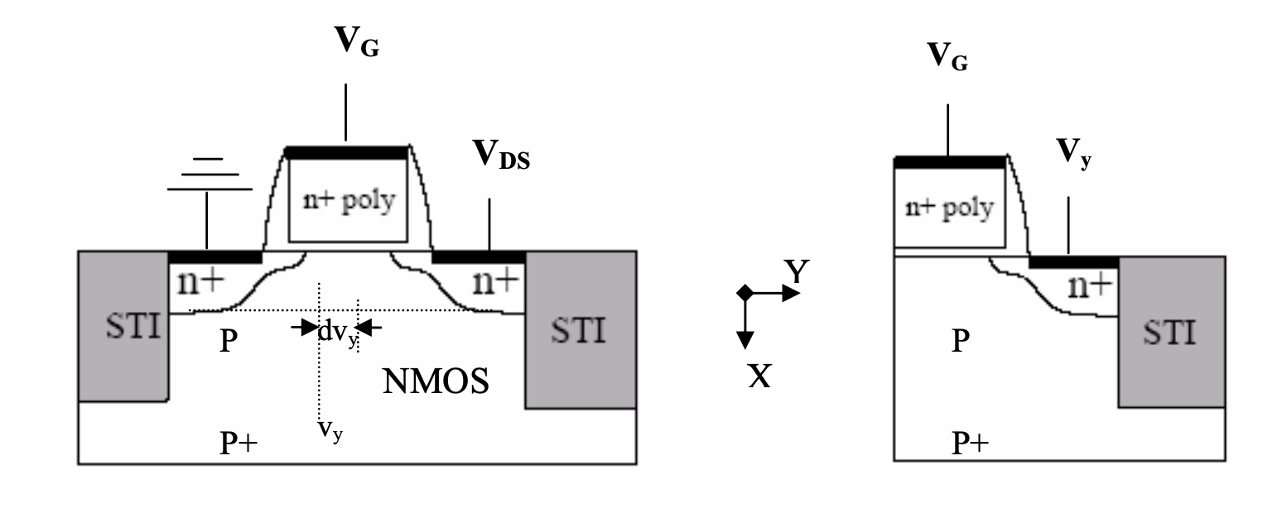
Formulation Of The Numerical Model
Figure 4: Cross-section of non-uniformly doped n-channel MOSFET. Cross-section of the controlled MOS structure corresponding the Quasi-equilibrium situation at the Conducting channel of the transistor [1]
Notes:
This illustration provides a cross-sectional view of a non-uniformly doped n-channel MOSFET (Metal-Oxide-Semiconductor Field-Effect Transistor). It represents the controlled MOS structure under quasi-equilibrium conditions at the conducting channel of the transistor.
Key Points:
Non-Uniform Doping: The doping concentration varies across the channel, affecting the transistor's electrical characteristics.
n-Channel MOSFET: Indicates that the majority carriers responsible for current flow are electrons.
Quasi-Equilibrium Situation: Refers to a state where the system is nearly in equilibrium, allowing for simplified analysis.
Controlled MOS Structure: Implies that the behavior of the MOSFET is regulated, and the conducting channel is a focal point for transistor operation.
Understanding the spatial distribution of dopants is crucial for optimizing the performance of MOSFETs in electronic devices.

Slide 19
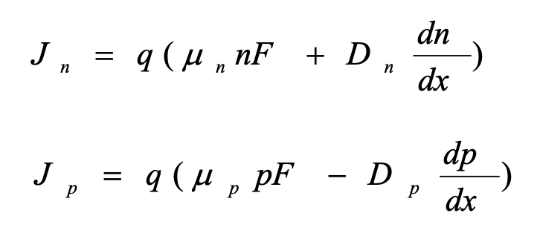
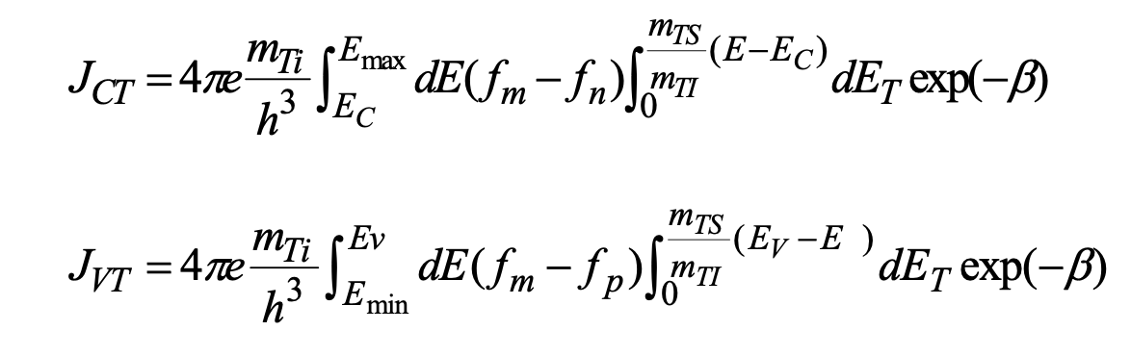
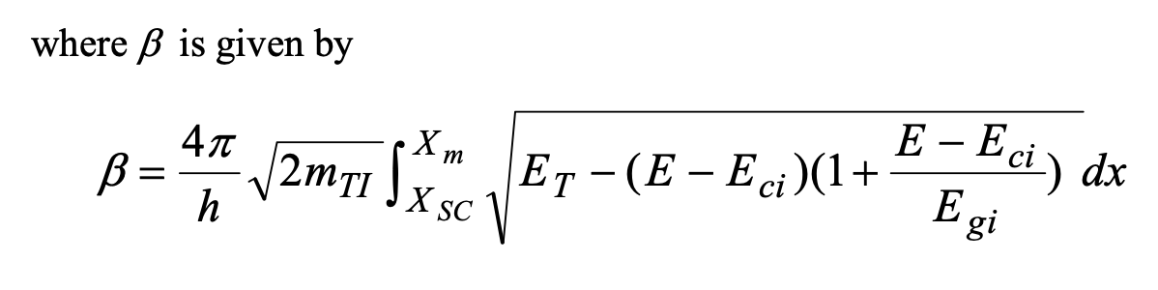
Formulation Of The Numerical Model
The MOSFET transistor, comprising a series of MIS controlled diodes along its channel, exhibits non-uniform doping in a one-dimensional x-direction. Quasi-Fermi levels vary with bias voltages (0 ≤ V_{Y} ≤ V_{DS}), and the device, with a non-uniformly doped substrate, is analyzed using a set of nonlinear equations numerically solved for MOSFET response, considering semiconductor transportation and gate-semiconductor tunneling interactions.
Current Transportation In The Semiconductor Region:
Characterization Of The Tunneling Through The Insulator:
Notes:
Formulation of the Numerical Model: MOSFET Transistor
"The MOSFET transistor is a complex semiconductor device characterized by a series of MIS (Metal-Insulator-Semiconductor) controlled diodes along its channel. In this model, we specifically address a one-dimensional x-direction with non-uniform doping.
Key Elements:
MIS Controlled Diodes: Representing Metal-Insulator-Semiconductor structures, these diodes play a crucial role in the transistor's operation.
Non-Uniform Doping: The doping concentration varies along the channel, impacting the device's electrical behavior.
Quasi-Fermi Levels: These levels vary with bias voltages (0 ≤ VY ≤ VDS), introducing complexity to the system's response.
Numerical Solution: The model employs a set of nonlinear equations numerically solved to capture MOSFET response.
Current Transportation in the Semiconductor Region:
Describes how carriers move within the semiconductor material, a fundamental aspect of transistor operation.
Characterization of Tunneling Through the Insulator:
Focuses on understanding the tunneling phenomenon through the insulator, emphasizing the gate-semiconductor interactions.
This numerical model is essential for comprehending the intricate behavior of MOSFET transistors under varying conditions.
The semiconductor region of the MOSFET is characterized by the following set of differential equations [6 and 7]
(a) Poisson’s equation is given by:
−d2ψ=dF =q[p(x)−n(x)+N(x)] dx2 dx ε
(2)
Where ψ(x) resembles the electric potential within the semiconductor and F
denotes the built-in electric field at the position x and N (x ) is the non-uniform
impurity distribution at any distance x. Note that x begins at the insulator- semiconductor interface along the semiconductor.
(3)
(4)
E−E p(x)=niexp i Fp 
Fn i  n(x)=nexpE −E(x)
 KT  J =q(μnF+D dn)
 KT 
i (b) The current density equations are:
n n ndx
J = q(μ pF − D dp ) p p pdx
where μn and μp as a function of impurity concentration are given by (Zambuto,1989).
1330 −65 1+[ N(x) ]0.76
dn = G − U + 1 dJ n dt q dx
dp = G − U − 1 dJ p dt q dx
where U is the net thermal generation-recombination rate Shockley-Read-Hall equation:
μn =
μp = (c) The electrons and holes continuity equations are:
+65.5
8.5 ⋅ 10 16 495−47.7
+47.7
(5)
(6)
which is usually given by
1+[ N(x) ]0.72 6.3 ⋅ 10 16
where τn and τp 1997)
pn − n2 i
6 (7)
U= as a function of impurity concentration are given by (Weber et al.,
(8)
τn(n+n1)+τp(p+ p1)
τ no 1+N(x)
τn= N ref
τ po 1+N(x)
τp= N ref
where Nref =2⋅1016 cm-3 , τno and τpo are the minority carrier lifetime for electrons and holes at lightly doped semiconductor and G is the number of electron-hole pairs (EHPs) generated per unite volume at a distance x from the insulator-semiconductor . According to the energy band diagram shown in Fig.5 there are net current JCT and JVT
flowing from the conduction and from the valence bands of the semiconductor to the gate contact. The tunneling current JCT and JVT can be evaluated using the independent electron approach outlined by Harison [8] for (100)-oriented silicon and, employing the expression given by Green and et al [9].
where β is given by
mE mTS(E−E)
J =4πe dE(f−f)mTI dEexp(−β) CT Ti∫max m n∫ C T
h3 EC 0 m Ev mTS(E−E)
(9) J =4πe dE(f−f)mTI dEexp(−β)
VT Ti∫mp∫V T h3 Emin 0
4πX E−E β = 2mTI ∫ m ET − (E − Eci )(1+ ci ) dx
h XSC Egi
(10)

Slide 20
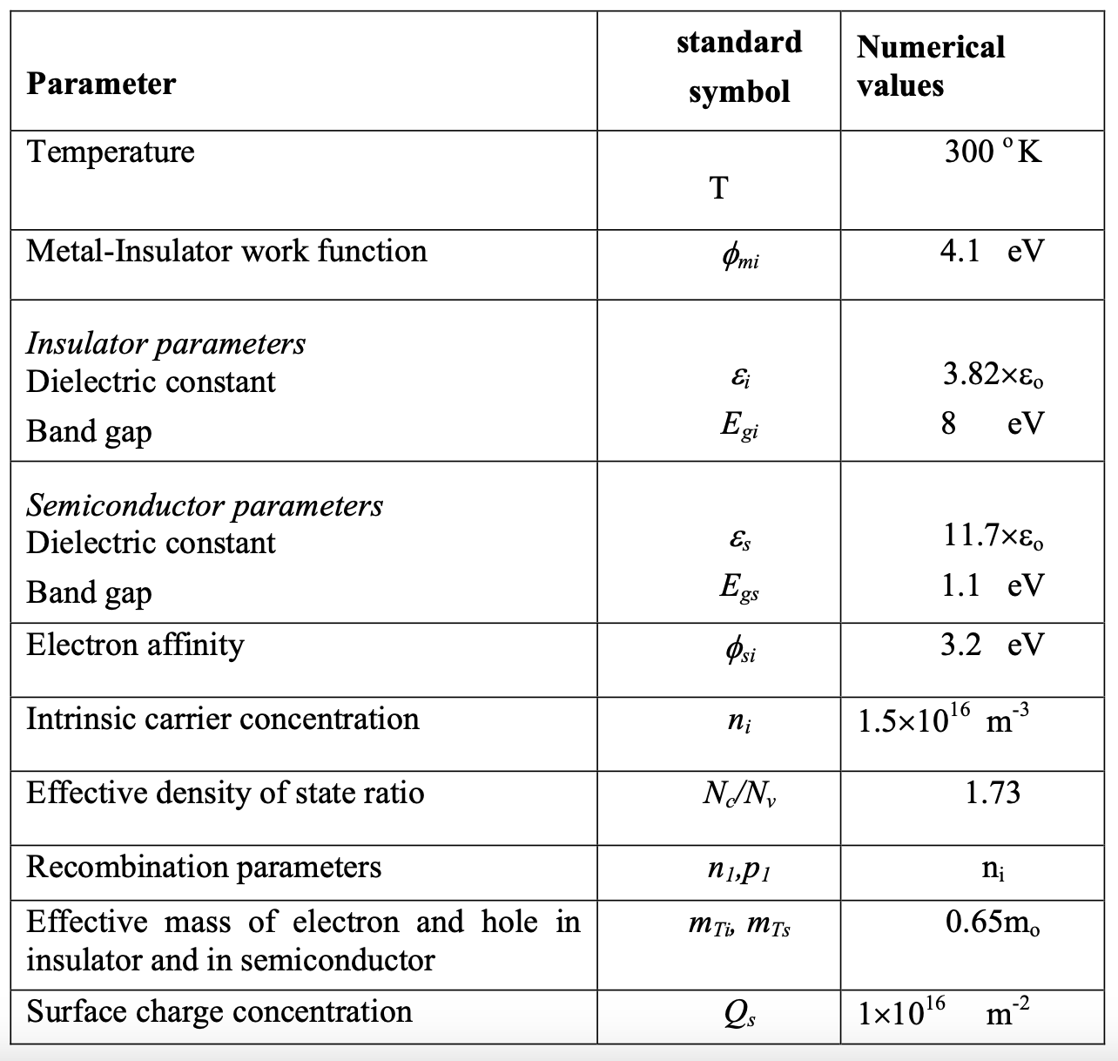
Numerical Results
Table 1: The basic input parameters for MOSFET device [4]

Slide 21
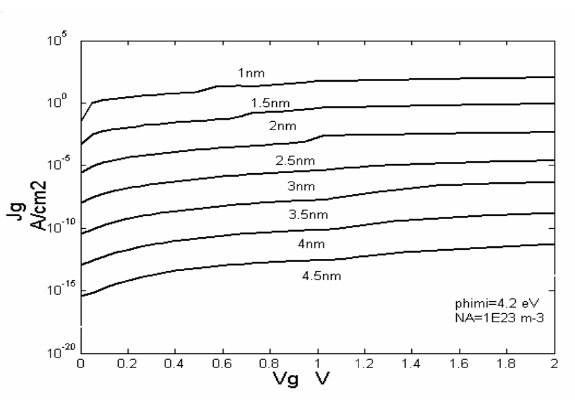
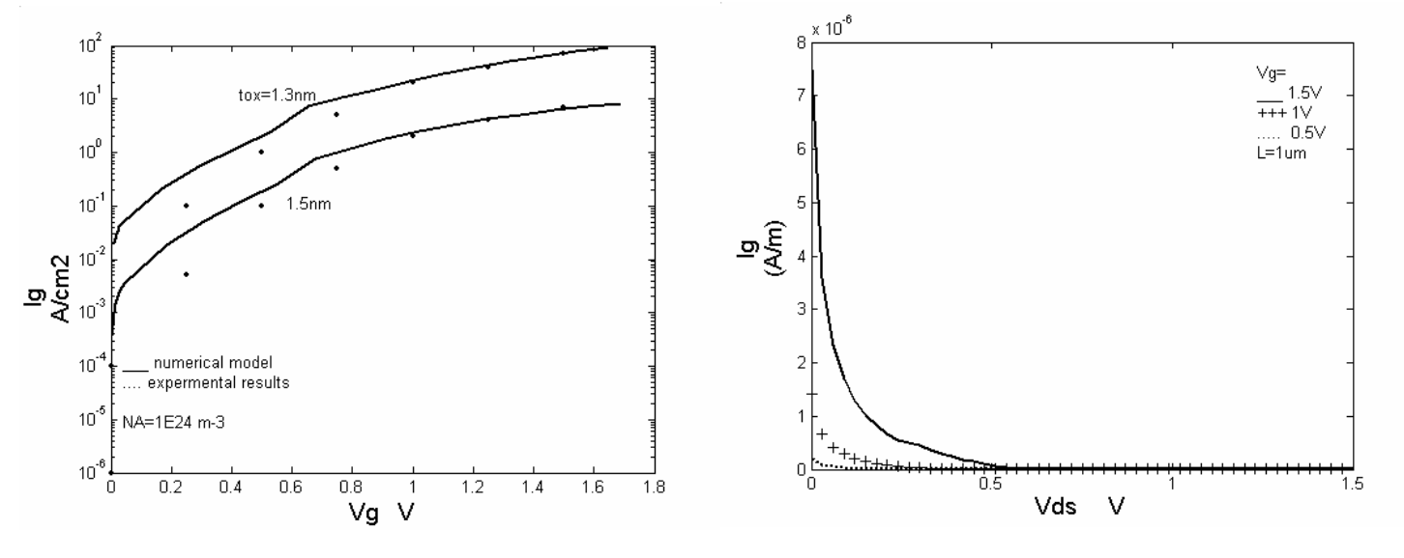
Numerical Results
Figure 6: Tunneling current as function of V_{G} at different values of t_{ox}. [4]
Figure 7: tunneling current as function of V_{DS} [4]
Figure 5: Tunneling current as function of V_{G} at different values of t_{ox} [4]
Notes:
Slide Notes:
**Figure 5: Tunneling Current as a Function of VG at Different Values of tox**
- This graph illustrates the relationship between tunneling current and gate voltage (VG) at varying oxide thicknesses (tox).
- Notice that as the oxide thickness decreases, there's a notable increase in gate current. This is because thinner oxides enhance the probability of carriers tunneling through the gate insulator, leading to a surge in tunneling current.
**Figure 6: Tunneling Current as a Function of VG at Different Values of tox [4]**
- This figure serves as a comparison between numerical simulation results and actual measurements [12].
- The simulated gate currents align well with the measured data for specific oxide thicknesses (1.5 and 1.3 nm). Discrepancies may arise from factors like surface roughness, effective oxide thickness determination, and voltage drop at the poly gate due to gate leakage.
**Figure 7: Tunneling Current as a Function of VDS [4]**
- Explores the impact of drain voltage (VDS) on gate tunneling current.
- The simulation demonstrates a decrease in gate current as drain bias increases. This is attributed to the rise in surface potential at the drain, reducing the voltage across the insulator.
**Insights:**
- The gate current's direction near the drain region may even reverse at higher drain potential than the gate.
- The overall gate tunneling current decreases as drain bias transitions from linear to saturation region operation, with the gate current effect being dominant in high VGS and low VDS bias conditions.

Slide 22
Numerical Results
The numerical findings are restricted to P-type silicon substrate MOSFET (n-channel) with a polysilicon gate contact, even though the calculations are typically valid for any other semiconductor materials for the substrate and any other materials for the gate contact. A list of the numerical values that correspond to the model parameters is shown in Table 1.
Oxide Thickness's Impact On The Gate Current
Reducing oxide thickness, as depicted in Figure 5, increases gate current due to enhanced carrier tunneling through the gate insulator, as shown in Figure 6's gate current versus voltage plots for various oxide thicknesses.
Discrepancies in Figure 6 between simulated and observed data for oxide thicknesses of 1.5 and 1.3 nm are likely attributed to factors like surface roughness, uncertainties in effective oxide thickness, and voltage drop at the poly-gate from gate leakage current.
Notes:
Numerical Findings and Model Constraints:
The presented numerical findings focus on P-type silicon substrate MOSFET (n-channel) with a polysilicon gate contact. It's crucial to note that these calculations are generally applicable to various semiconductor materials for the substrate and diverse materials for the gate contact.
Refer to Table 1 for a comprehensive list of numerical values corresponding to the model parameters.
Impact of Oxide Thickness on Gate Current:
As depicted in Figure 5, the reduction in oxide thickness directly correlates with an increase in gate current. This phenomenon is attributed to the heightened tunneling of carriers through the gate insulator.
Figure 6 showcases gate current versus voltage plots for different oxide thicknesses, highlighting the substantial impact of oxide thickness on gate current.
Discrepancies in Figure 6:
Notably, in Figure 6, discrepancies between simulated and observed data arise, particularly for oxide thicknesses of 1.5 and 1.3 nm. Possible contributors to these discrepancies include surface roughness, uncertainties in effective oxide thickness determination, and voltage drop at the poly-gate due to gate leakage current.

Slide 23
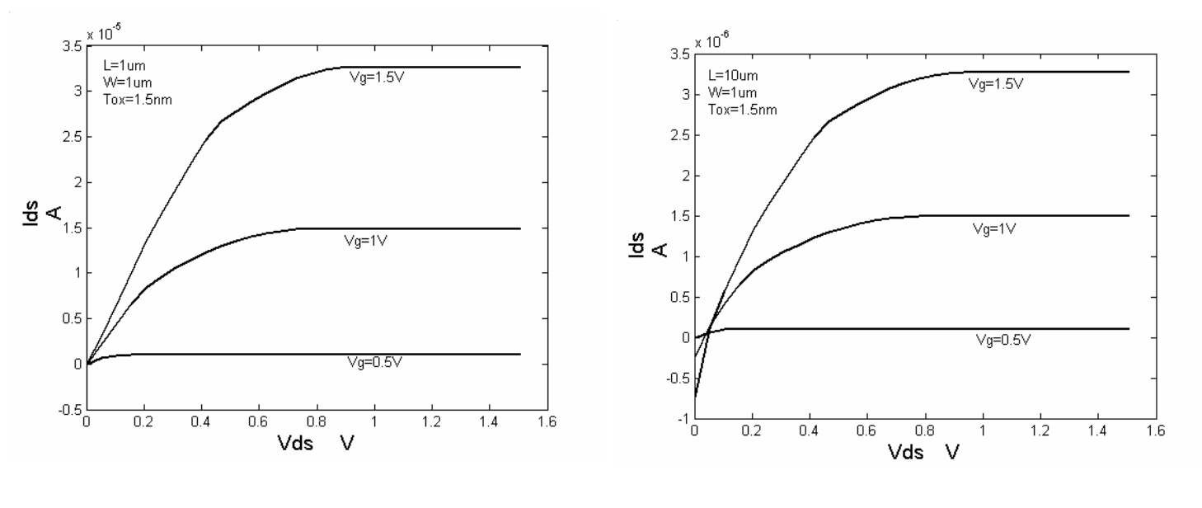
Numerical Results
Figure 8: the drain current as function of VDS for different channel length (a)L=1 μm (b) L=10 μm . [4]
Notes:
Slide Notes:
- **Figure 8: Drain Current vs. Drain-Source Voltage (VDS) for Different Channel Lengths:**
- Presented in Figure 8 are plots depicting the drain current as a function of VDS for varying channel lengths.
- Subplots (a) and (b) showcase the impact on drain current with channel lengths of 1 μm and 10 μm, respectively.
- **Effect of Gate Tunneling Current on Drain Current:**
- Examining the influence of gate tunneling current on drain current reveals interesting insights.
- In both subplots, the effect of gate tunneling current on drain current diminishes as the channel length decreases.
- **Short Channel MOSFETs:**
- For short channel MOSFETs (as observed in subplot a), the impact is less problematic. This is due to the significantly higher channel current, overshadowing the gate current, which decreases with reduced channel length.
- **Significance for Battery Operated Applications:**
- While the gate currents for an individual transistor may not be substantial, the cumulative effect of all gate currents across the entire chip can pose a serious issue, especially in applications reliant on battery operation.

Slide 24
Numerical Results
Drain Voltage's Impact On Gate Current
To take into consideration the effect of drain voltage on the current, the gate tunneling current is calculated as a function of drain voltage for different gate voltage levels, as shown in Fig. 7. As the drain bias increases, the simulated gate current decreases because of the higher surface potential at the drain, which reduces the voltage across the insulator.
The direction of gate current near the drain area may even reverse if the potential of the drain exceeds that of the gate. Under high VGS and low VDS bias conditions, the gate current influence is more pronounced. Consequently, when the drain bias changes from the linear to saturation region operation, the total gate tunneling current drops.
Tunneling Current's Impact On Drain Current
The effects of the gate tunneling current on the drain current for different channel lengths are shown in Fig. 8(a) and (b).It is clear that for short channel MOSFETs, the impact of the gate tunneling current on the drain current becomes less troublesome since the channel current is much larger than the gate current and the gate current decreases with decreasing channel length.
Even while the gate currents for a single transistor might not seem like much, the overall gate currents for the entire chip will be a serious problem for applications needing battery operation.
Notes:
Numerical Results:
Exploring the impact of various factors on the performance of MOSFETs reveals essential insights. Here, we delve into the numerical results concerning the influence of drain voltage on gate current and the subsequent repercussions on drain current.
Impact of Drain Voltage on Gate Current (Fig. 7):
Gate tunneling current is assessed against varying drain voltages for different gate voltage levels (Fig. 7).
Increasing drain bias leads to a decline in simulated gate current due to heightened surface potential at the drain, resulting in reduced voltage across the insulator.
Gate Current Reversal and Bias Conditions:
In regions of high VGS and low VDS biases, the influence of gate current becomes more pronounced.
Notably, the direction of gate current near the drain area may even reverse if the drain potential exceeds that of the gate.
Tunneling Current's Effect on Drain Current (Fig. 8):
Examining Fig. 8(a) and (b) elucidates the impact of gate tunneling current on drain current for varying channel lengths.
For short channel MOSFETs (as seen in Fig. 8(a)), the influence of gate tunneling on drain current is less problematic due to the substantially higher channel current overshadowing the gate current, especially as the channel length decreases.
Significance for Battery-Operated Applications:
Although the gate currents for an individual transistor may seem insignificant, the cumulative effect of all gate currents across the entire chip poses a serious concern, particularly in applications dependent on battery operation.

Slide 25
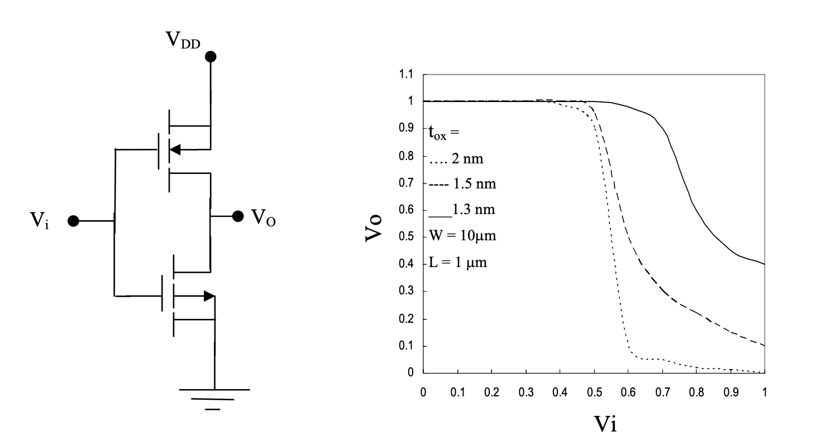
Circuit Simulations
Figure 9: Schematic of CMOS inverter. Transfer characteristics of CMOS Inverter for gate oxide thinner than 2nm [4]
Notes:
Circuit Simulations:
Transitioning from numerical insights to practical implications, circuit simulations were conducted to gauge the impact of gate current on the transfer characteristics of a CMOS inverter.
Schematic of CMOS Inverter (Fig. 9):
Fig. 9 depicts the schematic of a CMOS inverter. This fundamental building block in digital circuits serves as a representative case for studying the consequences of gate current on device performance.
Effect of Gate Current on Transfer Characteristics (Fig. 10):
Utilizing the numerical data obtained, simulations were performed to assess how gate current influences the transfer characteristics of the CMOS inverter (Fig. 10).
Notably, scaling down the oxide thickness to less than 2nm leads to a noteworthy increase in the output low-level voltage.
This escalation negatively impacts the noise margin and can result in faulty operation for the CMOS inverter.
Significance for Circuit Reliability:
The observed effects emphasize the critical role of gate current in determining the reliability and functionality of CMOS-based circuits, especially when operating with ultra-thin gate oxides. This insight is pivotal for designing robust and error-free electronic systems.

Slide 26
Circuit Simulations
Data Utilization: As seen in Figure 9, the influence of gate current on the transfer characteristics of the CMOS inverter is simulated using the numerical data from the trials.
Simulation Results: Figure 9 shows the outcomes of these simulations. They show what happens when the oxide thickness is reduced to less than 2 nm.
Implications: The output low-level voltage increases significantly when the oxide thickness is lowered to less than 2 nm. This increase makes the noise margin worse and increases the possibility of the CMOS inverter malfunctioning.
Notes:
Data Utilization:
The impact of gate current on the transfer characteristics of the CMOS inverter is evaluated using numerical data obtained from simulations (Fig. 9).
Simulation Results (Fig. 9):
Fig. 9 reveals the outcomes of these simulations, providing a visual representation of the effects observed when the oxide thickness is reduced to less than 2 nm.
Implications:
A key observation is the significant increase in the output low-level voltage with a reduction in oxide thickness below 2 nm.
This elevation in voltage adversely affects the noise margin and raises the likelihood of malfunctioning in the CMOS inverter.
Significance for Design and Reliability:
These findings underscore the critical importance of considering gate current effects, especially in the context of ultra-thin oxide layers, during the design phase to ensure the reliability and optimal performance of CMOS-based circuits.

Slide 27
Influence of Oxide Thickness
Oxide Thickness Determination: Initial observations were guided by ellipsometry, and precise oxide thickness calculation was obtained via C-V measurements that took into account the silicon accumulation layer. The effects of metallization on film reduction were investigated using a MOS array with CrAu metallization.
Capacitance Analysis: Even at high fields, capacitance study for a 40 A oxide layer showed non-saturation. The paper[2] provided a useful formula based on surface capacitance C in order to understand the role of the silicon accumulation layer.
Tunneling Current and Capacitance Correlation: The log of the tunneling current demonstrated a roughly proportionate connection with oxide thickness, highlighting homogeneity or a minor fluctuation in the oxide layer and showing great overall uniformity. A smooth association was discovered between the tunneling current and capacitance across neighboring MOS squares.
Notes:
Oxide Thickness Determination:
Initial observations utilized ellipsometry.
Precise oxide thickness calculation was achieved through C-V measurements, accounting for the silicon accumulation layer.
Investigated the impact of metallization on film reduction using a MOS array with CrAu metallization.
Capacitance Analysis:
Even under high fields, capacitance study for a 40 A oxide layer exhibited non-saturation.
Reference to a formula in the paper[2] based on surface capacitance C for understanding the role of the silicon accumulation layer.
Tunneling Current and Capacitance Correlation:
Log of tunneling current showed a proportional connection with oxide thickness.
Emphasized homogeneity or minor fluctuation in the oxide layer, showcasing overall uniformity.
Discovered a smooth association between tunneling current and capacitance across neighboring MOS squares.

Slide 28
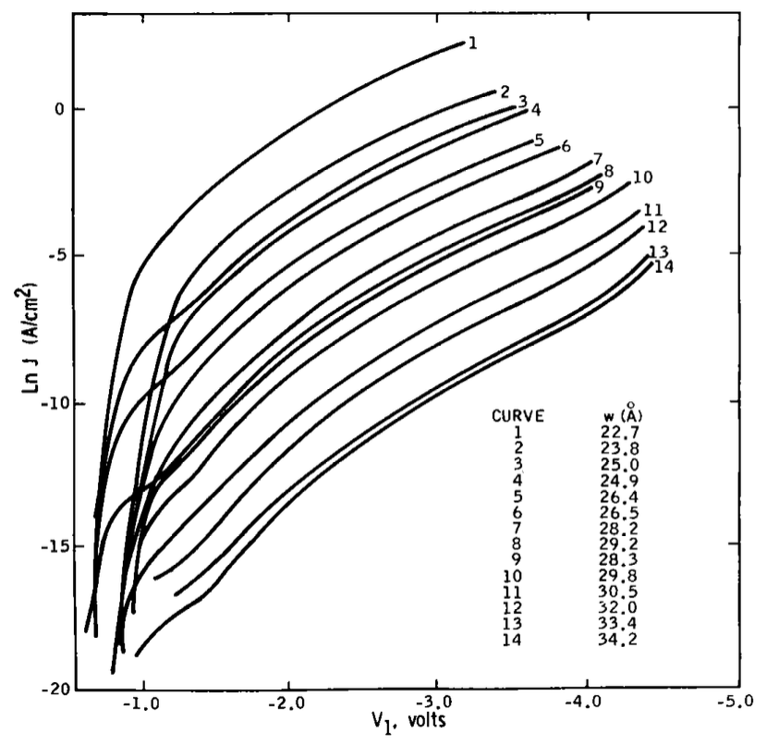
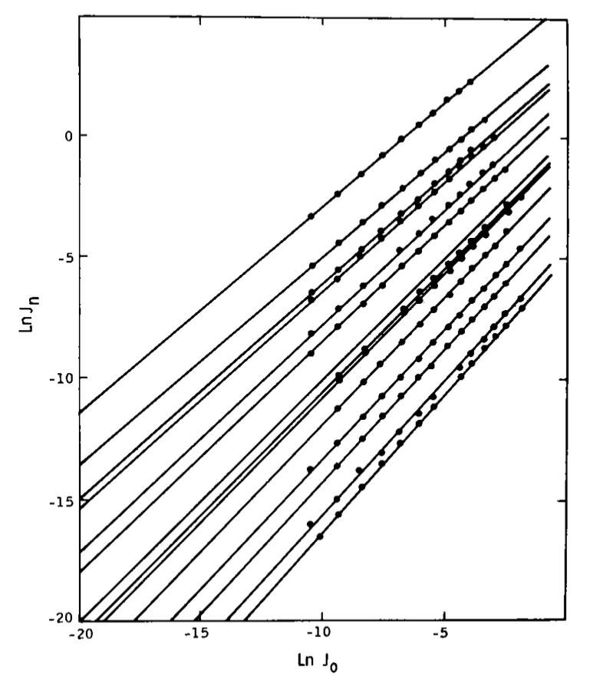
Influence of Oxide Thickness
Figure 10: Tunneling characteristics at various oxide thicknesses – Two wafers with various surface treatments yielded varied results. Tunneling current interdependency throughout oxide thicknesses. [2]
Notes:
**Slide Notes:**
- **Figures 4 and 5: Tunneling Characteristics:**
- **Figure 4:**
- Illustrates tunneling characteristics at liquid-nitrogen temperatures.
- Two wafers with varied surface treatments showed diverse results.
- Small systematic error in thickness measurements between wafers.
- Distinguished wafers at low voltages; one exhibited larger excess current due to tunneling into surface states.
- Convergence on the same dependence at higher voltages (regions II and III).
- Characteristics of regions II and III were reproducible across different wafers.
- Room-temperature measurements yielded similar characteristics with slightly higher currents.
- **Figure 5: Interdependence of Tunneling Currents:**
- Shows the interdependence of tunneling currents among devices with different oxide thicknesses.
- Log current values for different-thickness MOS devices plotted against the log current of one reference MOS device.
- Elastic tunneling points should fall on a straight line with slopes proportional to thickness.
- Inelastic tunneling into the indirect band (region II) reduces the slopes by an unknown amount.
- Plots serve as a qualitative check on the consistency of the data with a trapezoidal barrier.

Slide 29
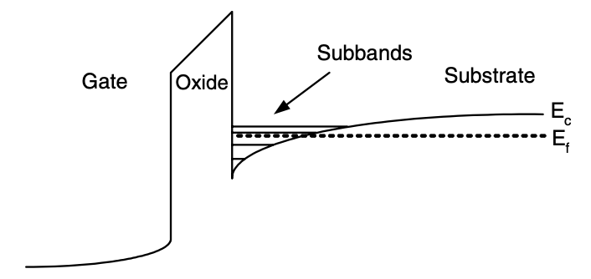
Quantization of energy in levels: Accumulation and Inversion
Figure 11. Diagrammatic band profile for a poly Si–SiO2–Si structure in inversion, demonstrating how carrier confinement in a limited potential well causes the creation of sub-bands. [1]

Slide 30
Quantization of energy in levels: Accumulation and Inversion
FN Formula Limitations: Electric field-induced band bending causes errors in the Fowler-Nordheim (FN) formula, which estimates semiconductor capacitance based on a three-dimensional free Fermi gas model. This causes a two-dimensional electron gas (2-DEG) to develop, and quantization effects have an impact on capacitance estimates by changing the carrier concentration distribution.
Quantized Electron Energies: The accumulation/inversion layers' quantized electron energies need a deviation from the free electron gas concept. A "carrier tunneling lifetime" for electrons in quantized energy levels is included in computations of gate tunneling current. This is ascertained by solving Schrödinger's equation simultaneously, which sheds light on how they behave in the potential well.
Barrier Lowering Considerations: Image-force-induced barrier reduction must be taken into account in gate tunneling current estimates, particularly for extremely thin oxides. This calls into question the traditional disregard for this component and highlights how good modeling is required to support existing tunneling forecasts.

Slide 31
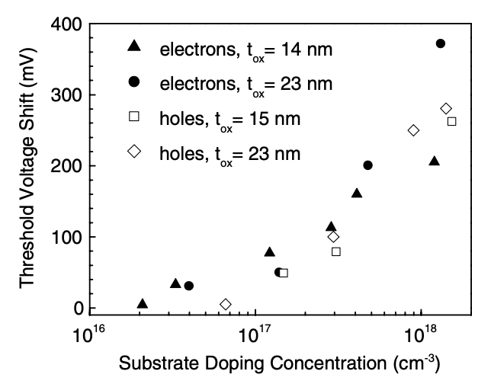
Quantization of energy in levels: Accumulation and Inversion
Figure 12. Variation in the threshold voltage for electron and hole inversion layers due to quantum-mechanical processes in the substrate as compared to the classical theory [1]

Slide 32
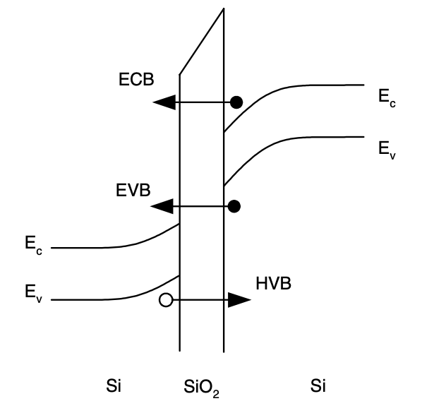
Components of tunneling currents
Figure 13: Diagrammatic illustration of the tunneling elements in a Si/ SiO2/Si structure. [1]
Notes:
Figure 13: Components of Tunneling Currents:Diagrammatically illustrates tunneling elements in a Si/SiO2/Si structure.
Apart from tunneling of electrons from the conduction band (ECB) at one side of the oxide barrier into the conduction band at the other side, other tunneling mechanisms exist for modern MOS structures.
These include:
Electron tunneling from the valence band into the conduction band (EVB).
Hole tunneling into the valence band (HVB).
Schematic representation in the band diagram for a Si-SiO2-Si structure is shown in Figure 13.
Note: HVB tunneling is equivalent to electron tunneling from the valence band to the valence band, in contrast to EVB tunneling, where the electron goes from the valence band into the conduction band.

Slide 33
Components of tunneling currents
In addition to traditional ECB electron tunneling, alternative processes include hole-to-valence (HBV) and valence-to-conduction (EVB) tunneling. In contrast to EVB tunneling, HVB tunneling is similar to electron tunneling inside the valence band.
Edge Direct Tunneling (EDT) becomes critical in short-channel devices, outperforming other leakage mechanisms such as gate-induced drain leakage (GIDL) and band-to-band tunneling (BTBT) for ultra-thin gate oxides, as Fig. 13 emphasizes the dominance of overlap currents, including EDT, even though the channel area is much larger than the overlap area.
Gate-to-channel current (Igc) in nMOS devices is primarily controlled by ECB during inversion and changes to EVB at high voltages in different operating zones. Table 2 shows how tunneling probabilities for nMOS and pMOS differ across ECB, EVB, and HVB based on variables such as carrier availability and barrier height.
Notes:
Additional Tunneling Processes:
Traditional electron tunneling from the conduction band (ECB) is a standard process.
Alternative processes include:
Hole-to-valence (HVB) tunneling.
Valence-to-conduction (EVB) tunneling.
HVB tunneling is similar to electron tunneling within the valence band.
Importance of Edge Direct Tunneling (EDT):
In short-channel devices, EDT becomes critical.
It outperforms other leakage mechanisms like gate-induced drain leakage (GIDL) and band-to-band tunneling (BTBT) for ultra-thin gate oxides.
Fig. 13 emphasizes the dominance of overlap currents, including EDT, even when the channel area is significantly larger than the overlap area.
Gate-to-Channel Current in nMOS Devices:
Primarily controlled by ECB during inversion.
Changes to EVB at high voltages in different operating zones.
Tunneling probabilities for nMOS and pMOS differ across ECB, EVB, and HVB based on variables such as carrier availability and barrier height (refer to Table 2).

Slide 34
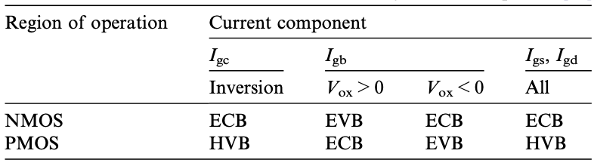
Components of tunneling currents
Table 2: Dominant current mechanisms for every component of the tunneling current. [1]
Notes:
Table 2: Dominant Tunneling Mechanisms by Component:
Understanding tunneling in MOS structures involves recognizing dominant mechanisms for each component of the tunneling current.
Operating Region Dependency:
In an nMOS in inversion:
Gate-to-Channel Current (Igc): Dominated by ECB.
Gate–Bulk Current (Igb): Caused by EVB at high voltages.
In accumulation:
Gate–Bulk Current (Igb): Caused by EVB.
No channel current.
Edge Direct Tunneling (EDT): Dominated by ECB in both inversion and accumulation.
Table 1 Summary:
Provides a comprehensive overview of the dominant mechanisms for each tunneling current component for both nMOS and pMOS structures.
Tunneling Probability Factors:
Barrier Height Variation:
The probability of tunneling for each mechanism depends on the height of the barrier.
The barrier height differs for holes and electrons.
Carrier Availability:
Tunneling probability is influenced by the availability of carriers in the material from which they tunnel.
State Availability:
Availability of states in the receiving material also affects tunneling probability.
These factors are crucial considerations in developing accurate models for tunneling current.

Slide 35
Components of tunneling currents
Gate Tunneling Current Calculations: Through the "carrier tunneling lifetime," which is obtained from self-consistent solutions of Schroedinger's and Poisson's equations, quantized energy levels contribute to tunneling current.In compact modeling, numerical techniques for handling carrier quantization effects are commonplace.
Position-Dependent Tunneling Current Density: In MOS transistors, understanding the position-dependent tunneling current density along the channel is crucial for optimizing device performance. This is influenced by factors such as the polysilicon gate and its depletion effects.
Determining Critical Tunneling Lifetime: Calculating the critical tunneling lifetime for gate current modeling involves methods treating quasi-bound states as bouncing particles or considering well/barrier scattering centers, with the transverse-resonant method offering numerical insights into energy broadening during tunneling.

Slide 36
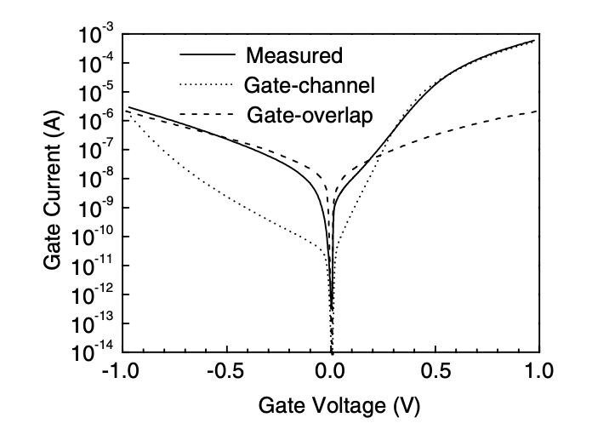
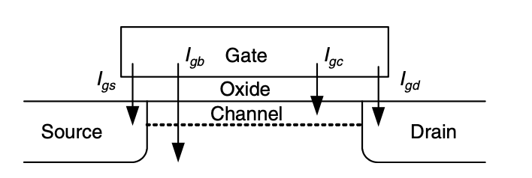
Components of tunneling currents
Figure 14: MOS transistor gate tunneling current components – Gate current measured for an n+ Si/SiO2/p Si MOS capacitor with an n+ source, solid line representing W/L = 562/62 lm and tox = 1.6 nm. The computed gate-overlap and gate-channel components are displayed by the dashed and dotted lines, respectively. Although the overlap area is substantially lower than the channel area, the overlap current component is dominating at low positive and negative gate voltages (depletion–accumulation). [1]

Slide 37
Current Distribution in MOSFET Channels
Gate Current Partitioning: In an inversion, gate current partitions into source and drain according to bias-dependent ratios (Igcs/Igc and Igcd/Igc), which equalize at zero bias. The difficulty in experimentally verifying these ratios highlights how difficult it is to measure current partitioning.
Position-Dependent Tunneling Current Density: The drain-source voltage causes position-dependent tunneling current density in MOS transistors. Current density (Jg) is integrated over the channel by the total gate current (Ig), where effective width (W) and length (L) are important parameters. Increased current moves to the source due to elevated drain-source voltage, which affects the distribution of gate current overall.
Polysilicon Gate Depletion: As shown in C–V measurements for thin-oxide MOSFETs, highly doped polysilicon gates that are depleting depart from perfect conductors, producing a voltage drop and influencing oxide voltage in tunneling current estimates, which are essential for exact modeling and accurate device parameter extraction.

Slide 38
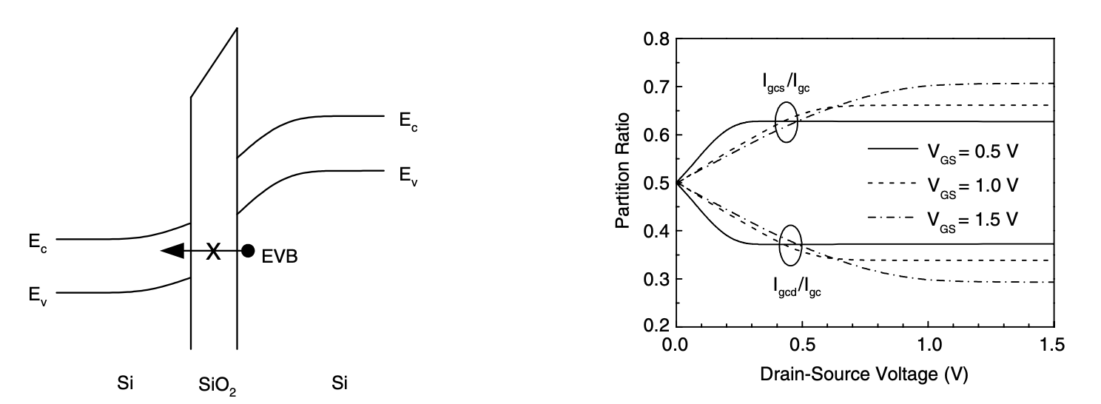
Current Distribution in MOSFET Channels
Figure 15: Diagrammatic band diagram illustrating the need for receiving states inside the semiconductor's energy gap in order to enable EVB tunneling for low voltages across the oxide. For varying gate-source voltages, the channel tunneling current partition ratio as a function of drain voltage [1]

Slide 39
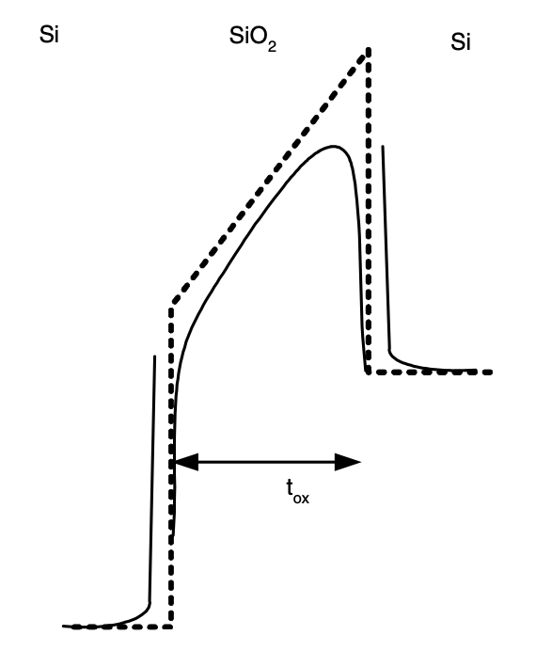
Potential Barrier Lowering Through Image Forces
Figure 16: Potential barrier at the Si–SiO2 interface without image forces (dashed line) and with image forces (solid line) [1]
Notes:
Potential Barrier Lowering Through Image Forces:Figure 18:
Illustrates the potential barrier at the Si–SiO2 interface.
Without Image Forces (Dashed Line): Traditional calculation.
With Image Forces (Solid Line): Reflects potential barrier lowering.
Historical Neglect:
Image-force impact on barrier often neglected in tunneling current calculations, especially for large barriers (Si–SiO2).
Supported by Weinberg's argument in 1982 and experimental evidence at the time.
Consideration for Thin Oxides:
For very thin oxides, potential barrier lowering due to image forces can be significant.
Recent results challenge the effectiveness of using an '‘effective’’ trapezoidal barrier to account for image force effects, suggesting potential modeling limitations [54].

Slide 40
Potential Barrier Lowering Through Image Forces
Potential Barrier Lowering: When calculating the tunneling current, it is common to overlook the lowering of the potential barrier in MOS structures brought on by image forces. Weinberg (1982) made this reasoning, which states that the image-force lowering of the barrier is relatively minor for big barriers (such as in Si-SiO2). At the time, experimental data confirmed this.
Thin Oxides Consideration: The tunneling current computation may be significantly affected by the barrier reduction for very thin oxides. To take into consideration image force effects, a decreased version of the ideal trapezoidal barrier, referred to as the "effective" barrier, has been developed.
Recent Findings: According to recent findings, this technique would not accurately describe the tunneling current dependency on the field. This implies that further studies are necessary to precisely simulate how potential barrier reduction affects tunneling current in MOS systems with extremely thin oxide layers.
Notes:
Potential Barrier Lowering:
When calculating tunneling current, the common practice is to disregard the potential barrier reduction in MOS structures due to image forces.
Weinberg's Reasoning (1982):
Argued that for large barriers (like Si-SiO2), the image-force impact on barrier reduction is negligible.
Supported by experimental data at that time.
Thin Oxides Consideration:
In cases of very thin oxides, potential barrier reduction due to image forces can be significant.
To address image force effects, an "effective" trapezoidal barrier, lowered compared to the ideal one, has been introduced.
Recent Findings:
Recent research challenges the efficacy of the "effective" barrier method.
Indicates that this approach might not accurately capture the tunneling current's dependency on the electric field.
Further studies are needed to precisely model the impact of potential barrier reduction on tunneling current in MOS systems with extremely thin oxide layers.

Slide 41
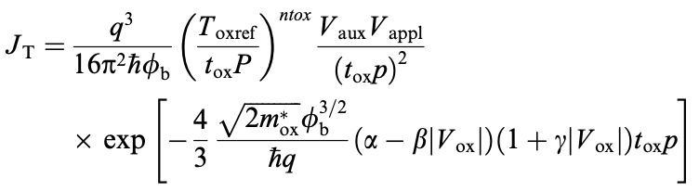
Compact MOS Models: Understanding and Analyzing Gate Current
BSIM4
Model Overview: Version 4.0.0 of the Berkeley Short-channel IGFET Model (BSIM), which is extensively utilized in circuit modeling, incorporates gate tunneling current. Based on Lee and Hu's semi-empirical model, the BSIM4 gate current model provides a consistent formulation for several tunneling current components and mechanisms:
Model Expression: Every part and mechanism of the tunneling current is represented by a single expression in the model. It considers a number of variables, including the current component, the operating region, and the tunneling process. The currents and current densities are also provided.
Notes:
Compact MOS Models: Understanding Gate Current
BSIM4 Model Overview:
Version 4.0.0 of the Berkeley Short-channel IGFET Model (BSIM) is widely used in circuit modeling.
It incorporates a comprehensive gate tunneling current model.
Model Basis:
Based on Lee and Hu's semi-empirical model.
Offers a consistent formulation for various tunneling current components and mechanisms.
Model Expression:
Each part and mechanism of the tunneling current is represented by a single expression in the model.
Factors in variables like current component, operating region, and tunneling process.
Provides expressions for both currents and current densities.
Utilization:
Allows for a detailed understanding and analysis of gate tunneling current in MOS devices.
Valuable for accurate circuit simulations and performance predictions.
Considerations:
Essential for engineers and researchers dealing with MOS device modeling and analysis.
Enhances the precision of simulations, especially in scenarios involving gate tunneling effects.
where Toxref is a reference oxide thickness at which the parameters are extracted, ntox is a fitting parameter, Vappl is the applied voltage (which has a different meaning depending on the current component), and the function Vaux and the parameters a, b, c and p depend on the tunnel- ing mechanism (ECB, EVB or HVB), the region of opera- tion (inversion, accumulation or depletion) and the current component (Igb, Igc, Igs or Igd). Table 2 shows the parame- ter values, as well as the definition of the auxiliary function Vaux and the applied voltage Vappl, for each operating re- gion and current component.

Slide 42
Compact MOS Models: Understanding and Analyzing Gate Current
BSIM4
Model Considerations: The gate-channel current is divided into components by the BSIM4 model. It guarantees a seamless transition from the triode area to the saturation zone and accounts for the depletion in the polysilicon region.
Philips MOS Model 11
Model Overview: Unlike threshold voltage-based models, the Philips MOS Model 11 has an explicit surface potential formulation, considers tunneling current to be unimportant, and provides tunneling probabilities dependent on characteristics such as oxide voltage and inversion layer charge.
Notes:
BSIM4 Model Considerations:
Current Division:
The BSIM4 model divides the gate-channel current into distinct components.
Ensures a smooth transition from the triode region to the saturation zone.
Accounts for depletion effects in the polysilicon region.
Philips MOS Model 11 Overview:
Surface Potential Formulation:
Unlike threshold voltage-based models, it employs an explicit surface potential formulation.
Does not consider tunneling current to be significant.
Provides tunneling probabilities based on characteristics like oxide voltage and inversion layer charge.
Characteristics:
Tailored for specific scenarios where tunneling effects might not be dominant.
Explicitly addresses surface potential, offering a unique perspective in MOS modeling.
Useful in situations where a threshold voltage-centric approach may not be as accurate.

Slide 43
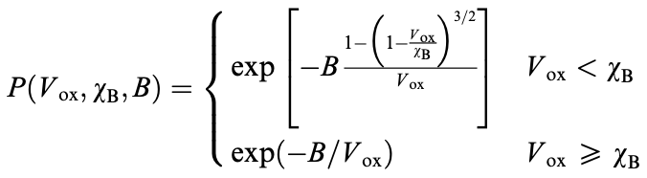
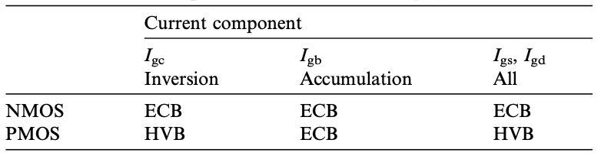
Compact MOS Models: Understanding and Analyzing Gate Current
Philips MOS Model 11
The tunneling probability for each tunneling component and operational zone is provided by:
Table 3: MOS Model 11's dominant current components [1]
Notes:
Philips MOS Model 11 Tunneling Probability:
Comprehensive Analysis:
The model offers tunneling probabilities for each tunneling component across various operational zones.
Provides a detailed understanding of the dominant mechanisms influencing tunneling.
Table 3: Dominant Current Components:
Summarizes the primary tunneling mechanisms considered in MOS Model 11 for each operational region.
Important to note that MOS Model 11 excludes consideration of electron valence band (EVB) tunneling.
Inversion gate-to-bulk current is not considered due to the exclusion of EVB tunneling in this model. where Vox, vB, and B depend on the tunneling mechanism and region of operation. The expression for Vox > vB corre- sponds to Fowler–Nordheim tunneling (1), and the expres- sion for Vox < vB is essentially the WKB direct tunneling probability with a triangular barrier for tunneling from a single energy level.

Slide 44
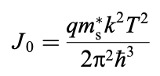
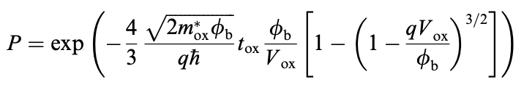
Compact MOS Models: Understanding and Analyzing Gate Current
SP model
Model Overview: The SP model is a small MOS model based on surface potentials. The foundation of its gate current model is equation (3). Assuming that both the supply function and the tunneling probability are independent of energy, the tunneling current density may be expressed more simply as follows:
Model Considerations: The SP model linearizes the supply function and the exponent of the tunneling probability to get an approximate closed-form formula for the gate-channel current. In SP, the overlap currents are likewise modeled, and equations provide the gate-channel current division.
Notes:
SP Model Overview:
Nature of the Model:
The SP model is a compact MOS model with a focus on surface potentials.
It leverages equation (3) as the foundation for its gate current model.
Simplified Tunneling Current Density:
Assumption:
The SP model assumes independence of the supply function and tunneling probability on energy.
Simplified Expression:
This assumption allows for a simplified expression of the tunneling current density.
Model Considerations:
Linearization Process:
The SP model linearizes the supply function and tunneling probability exponents.
This linearization results in an approximate closed-form formula for the gate-channel current.
Overlap Currents:
Overlap currents are also considered in the SP model.
Equations within the model address the division of gate-channel current.

Slide 45
Compact MOS Models: Understanding and Analyzing Gate Current
HiSIM
Model Overview: The compact Hiroshima University STARC IGFET Model (HiSIM) is based on the drain current drift-diffusion approximation. The surface potential at the source and drain sides of the MOSFET's channel provides an analytical description of every device feature.
Model Expression: Based on band-to-band tunneling theory, the gate current model in HiSIM solely takes ECB tunneling into account. The energy gap of the bulk semiconductor, the threshold voltage change brought on by short-channel effects, and the model parameters GLEAK1, GLEAK2, and GLEAK3 are all included in the equation.
Model Considerations: In HiSIM, the partition of the gate current is based on formulas. By assuming that the tunneling current density varies linearly with the position along the channel, analytical equations for the gate current's source and drain components may be found.
Notes:
HiSIM Model Overview:
Nature of the Model:
The Hiroshima University STARC IGFET Model (HiSIM) is a compact model based on the drain current drift-diffusion approximation.
It employs the surface potential at the source and drain sides for a detailed description of MOSFET features.
Gate Current Model:
Incorporating Band-to-Band Tunneling:
HiSIM's gate current model is based on band-to-band tunneling theory.
Specifically, it considers only Electron Conduction Band (ECB) tunneling.
Equation Components:
Parameters and Variables:
The equation includes factors like the energy gap of the bulk semiconductor, threshold voltage changes due to short-channel effects, and parameters GLEAK1, GLEAK2, and GLEAK3.
Model Considerations:
Gate Current Partition:
In HiSIM, formulas determine the partition of the gate current.
Linear variations of tunneling current density along the channel are assumed, leading to analytical equations for source and drain components of the gate current.

Slide 46
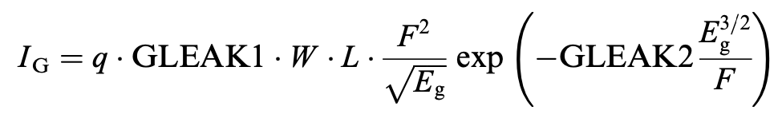
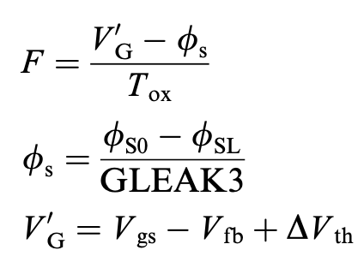
Compact MOS Models: Understanding and Analyzing Gate Current
HiSIM
where,
and, DVth is the threshold voltage shift with respect
to the long-channel Vt caused by short-channel effects,
and Eg is the bulk semiconductor's energy gap. The
model parameters are GLEAK1, GLEAK2, and GLEAK3.
Notes:
Equation Components:
Threshold Voltage Shift (DVth):
Represents the shift in threshold voltage due to short-channel effects concerning long-channel Vt.
Bulk Semiconductor Energy Gap (Eg):
Signifies the energy gap of the bulk semiconductor.
Model Parameters:
GLEAK1, GLEAK2, and GLEAK3 are model parameters that contribute to the overall equation.
Parameter Influence:
GLEAK Parameters:
The values of GLEAK1, GLEAK2, and GLEAK3 play a crucial role in determining the characteristics of the HiSIM model.
They influence how the gate current is modeled in response to different operational conditions and device configurations.

Slide 47
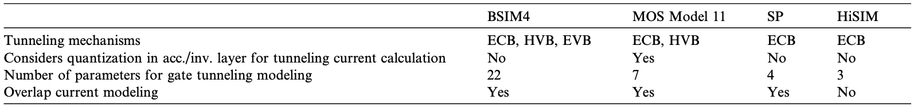
Compact MOS Models: Understanding and Analyzing Gate Current
Table 4: Comparison of gate current compact models [1]
Notes:
BSIM4:
Model Overview:
Berkeley Short-channel IGFET Model (BSIM4).
Employs Lee and Hu's semi-empirical model for gate tunneling current.
Considerations:
Provides a consistent formulation for various tunneling current components and mechanisms.
Represents each part and mechanism with a single expression.
Philips MOS Model 11:
Model Overview:
Explicit surface potential formulation.
Tunneling current is deemed unimportant.
Considerations:
Considers tunneling probabilities dependent on oxide voltage and inversion layer charge.
Dominant tunneling mechanisms presented in Table 3.
SP Model:
Model Overview:
Small MOS model based on surface potentials.
Linearizes supply function and tunneling probability.
Considerations:
Expresses tunneling current density more simply.
Models overlap currents and provides equations for gate-channel current division.
HiSIM:
Model Overview:
Hiroshima University STARC IGFET Model (HiSIM).
Based on the drain current drift-diffusion approximation.
Considerations:
Gate current model focuses solely on ECB tunneling.
Partition of gate current based on formulas.
Table 4: Comparison:
Parameters Compared:
Compares key aspects of tunneling current modeling in these four compact models.
Insights:
Highlights differences in approach, considerations, and focus areas for each model.
Use Case Implications:
Discusses potential implications for selecting a model based on specific simulation requirements or device characteristics.
Conclusion:
Decision Considerations:
Engineers and researchers should choose a model based on the specific needs and characteristics of their simulation or study.
Ongoing Research:
Constant evolution in semiconductor technology may lead to further refinements in these models. Ongoing research and updates are essential for accurate device simulations.

Slide 48
Consequences of Gate Tunneling Current on Device Performance
Digital and analog circuit performance
Despite worries about heat and durability, MOS devices with a gate oxide thickness of 1.5 nm in 1994 showed a high tunneling current density, indicating tolerance for up to 1000 A/cm² in high-performance applications.
In low-power, memory, and analog circuit applications where large-geometry devices or low gate currents are essential, a minimum gate oxide thickness of 1.8–2.6 nm may be required.
Sample-and-hold cells, CMOS logic, MOS RF, and analog circuits are all impacted by gate tunneling current, which can cause problems including higher static power dissipation, voltage swing deviations, and effects on circuit characteristics. Investigating these factors further is necessary to understand them.
Notes:
Gate Tunneling Current Impact:Digital and Analog Circuit Performance:
MOS devices in 1994 with a gate oxide thickness of 1.5 nm exhibited high tunneling current density.
Tolerance observed up to 1000 A/cm² in high-performance applications.
Gate Oxide Thickness Requirements:
In low-power, memory, and analog circuit applications:
Minimum gate oxide thickness of 1.8–2.6 nm may be necessary.
Applications Affected:
Sample-and-hold cells, CMOS logic, MOS RF, and analog circuits are impacted.
Issues Introduced:
Consequences include higher static power dissipation, voltage swing deviations, and effects on circuit characteristics.
Further Investigation:
Understanding these factors requires in-depth investigation.
Constant research and analysis essential for optimizing performance and addressing challenges in various applications.
Device Performance Implications:
Digital and Analog Circuit Performance:
MOS devices with a 1.5 nm gate oxide thickness in 1994 exhibited high tunneling current density.
Tolerance observed up to 1000 A/cm² in high-performance applications despite concerns about heat and durability.
Gate Oxide Thickness Requirements:
Low-Power, Memory, and Analog Circuits:
Gate oxide thickness of 1.8–2.6 nm may be necessary for large-geometry devices or low gate currents in specific applications.
Impacted Applications:
Sample-and-Hold Cells, CMOS Logic, MOS RF, Analog Circuits:
Gate tunneling current affects various applications, leading to challenges like higher static power dissipation and voltage swing deviations.
Investigation Importance:
Understanding Circuit Characteristics:
Further research needed to comprehensively understand the impact of gate tunneling current on circuit characteristics in various applications.
Conclusion:
Balancing Act:
Engineers must balance the need for performance with considerations related to gate tunneling current, especially in applications with specific geometric or power requirements.
Continued Research:
Ongoing investigations are crucial to unveil the intricacies of how gate tunneling current influences different types of circuits and devise strategies to mitigate its adverse effects.

Slide 49
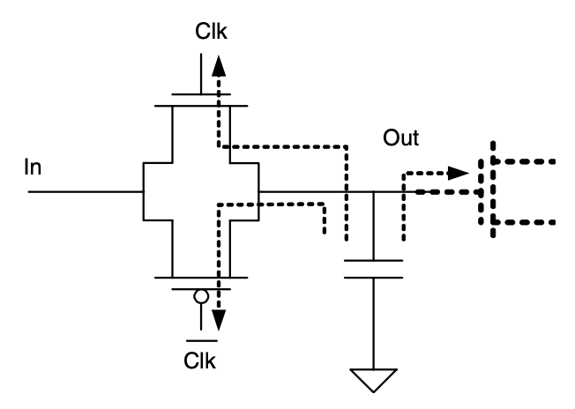
Consequences of Gate Tunneling Current on Device Performance
Figure 17: CMOS sample and hold circuit, illustrating potential gate current leakage paths [1]
Notes:
Illustration of CMOS Sample and Hold Circuit:
Figure 20:
Displays a CMOS sample-and-hold circuit.
Highlights potential gate current leakage paths.
Importance of Sample-and-Hold Cell:
Primary Application:
One of the first circuit applications affected by gate current leakage.
Crucial for maintaining a constant voltage in the capacitor during the 'hold' phase.
Effect of Gate Current on Circuit Operation:
During 'Hold' Phase:
Voltage in the capacitor should remain constant.
Gate current disrupts this, causing issues in maintaining stability.
Leakage Paths:
Current flows through source/drain overlap extensions of sampling transistors.
Alternatively, it may flow through the gate of the transistor connected to the output for signal readout.
Consequences and Applications:
Impact on A/D Converters:
Inability to hold charge affects applications like A/D converters.
Necessitates a considerable increase in sampling frequency to compensate.
Implications for Design and Frequency Considerations:
Design Considerations:
Designers must address gate current leakage in circuit designs.
Frequency Adjustments:
Compensation strategies or increased sampling frequencies may be necessary to counter the effects of gate current in critical applications like A/D conversion.

Slide 50
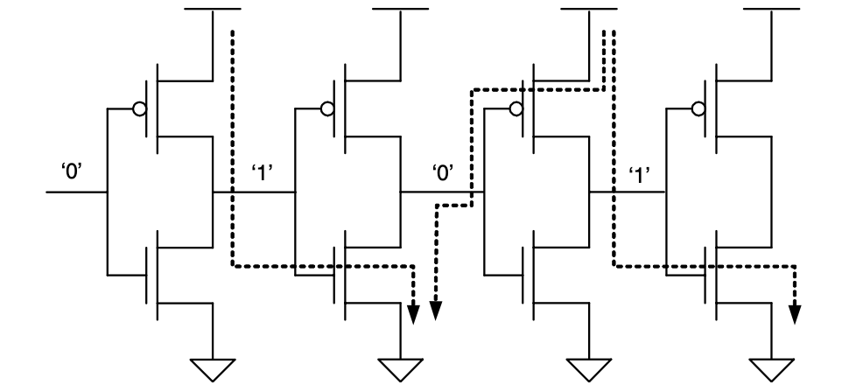
Consequences of Gate Tunneling Current on Device Performance
Figure 18: CMOS inverter chain illustrating the DC current flow between stages brought on by the gate tunneling current. [1]
Notes:
Illustration of CMOS Inverter Chain:
Figure 21:
Displays a CMOS inverter chain.
Illustrates the DC current flow between stages due to gate tunneling current.
Significance of CMOS Inverter:
Basic Building Block:
Essential component of CMOS logic.
Key features include low standby power consumption, high fan in/fan out, and good noise immunity.
Impact of Gate Tunneling Current:
Power Dissipation:
Static power dissipation increases exponentially with decreasing oxide thickness.
Thick-oxide technology has low static power dissipation compared to dynamic power dissipation.
Voltage Swing and Noise Margin:
Voltage Swing Impact:
Gate current in one stage, provided by the previous stage, causes a voltage drop in the channel along this current path.
Noise Margin Degradation:
Logic low and high voltages deviate from supply source values, degrading the noise margin.
Effect on Logic Levels:
Higher tunneling current in nMOS devices affects the 'high' logic level more than the 'low' level.
Considerations for CMOS Logic Design:
Voltage Stability:
Designers must account for potential voltage deviations caused by gate tunneling current.
Tunneling Current Management:
Strategies for managing tunneling currents become critical in maintaining reliable CMOS logic operation.

Slide 51
Consequences of Gate Tunneling Current on Device Performance
Noise
In digital, analog, and radiofrequency applications, noise in electronic circuits is a major problem as it affects bit errors in logic circuits and establishes the lower bound of the dynamic range in analog and radiofrequency systems.
Large gate tunneling current MOS devices introduce additional noise sources, including as low-frequency noise with an approximate 1/f dependency and shot noise with a frequency-independent spectral density.
At low frequencies, gate current low-frequency noise has significant ramifications and is linked to trap-related phenomena such as trap-assisted tunneling or local oscillations of tunneling probability. It is possible for this phenomena to also have an impact on drain current noise.
Notes:
verview of Noise in Electronic Circuits:
Digital, Analog, and RF Applications:
Noise is a significant concern in electronic circuits across various applications:
Affects bit errors in logic circuits.
Establishes the lower bound of the dynamic range in analog and radiofrequency (RF) systems.
Gate Tunneling Current and Additional Noise Sources:
Large Devices Introduce Noise:
Large gate tunneling current MOS devices bring additional noise sources.
Types of Noise Introduced:
Low-Frequency Noise:
Exhibits an approximate 1/f dependency.
Shot Noise:
Features a frequency-independent spectral density.
Ramifications of Gate Current Low-Frequency Noise:
Significant Ramifications:
At low frequencies, gate current low-frequency noise has noteworthy consequences.
Link to Trap-Related Phenomena:
Linked to trap-related phenomena like trap-assisted tunneling or local oscillations of tunneling probability.
Potential Impact on Drain Current Noise:
This phenomena might also impact drain current noise.
Implications for Circuit Design:
Consideration in Design:
Designers must consider and manage the impact of gate tunneling current noise, especially in applications sensitive to noise levels.

Slide 52
Conclusion
It has been looked at how the gate current affects the CMOS inverter's ability to work. It has been discovered that when the gate thickness is less than 2 nm, the output low-level voltage rises. This increase makes the noise margin worse and increases the possibility of the CMOS inverter malfunctioning.
Modern MOSFET technology has shortcomings in the Fowler-Nordheim tunneling concept, requiring more sophisticated models. Compact MOS models that are often used in the industry are described together with modeling techniques and constraints, emphasizing possible errors brought on by oversimplifications and non-physical elements.
The issues for device, circuit, and system designers were brought to light during the discussion of how tunneling current affects circuit performance. Although this has implications for different applications, it was pointed out that this shouldn't stop the downscaling of MOS devices; on the contrary, it should provide new difficulties.
Notes:
Impact on CMOS Inverter:
Examination of how gate current influences CMOS inverter performance.
Findings reveal that gate thickness below 2 nm leads to increased output low-level voltage.
Consequence: Deterioration of noise margin and heightened risk of CMOS inverter malfunction.
Challenges in Fowler-Nordheim Tunneling Concept:
Limitations in Fowler-Nordheim tunneling concept highlighted for modern MOSFET technology.
Need for more advanced models to address these shortcomings.
Compact MOS Models:
Overview of widely used compact MOS models in the industry.
Emphasis on modeling techniques and constraints.
Caution against oversimplifications and inclusion of non-physical elements in models.
Issues for Designers:
Illumination of challenges faced by device, circuit, and system designers.
Acknowledgment of implications for various applications.
Emphasis on not hindering MOS device downscaling but transforming challenges into opportunities.
Moving Forward:
Acknowledgment that despite challenges, the evolution of MOS devices should continue.
Viewed as an opportunity for innovation and problem-solving in the field.
Conclusion:
Recognition of the complexities surrounding gate tunneling current.
Encouragement for ongoing research, innovation, and adaptation in MOSFET technology.
Significance of MOS Structures: Semiconductor devices, particularly MOS structures, have played a transformative role in various sectors due to their impact on electronics, computing, telecommunications, energy, and healthcare.
Importance of MOS Structures in the Digital Era: MOS structures, particularly those utilizing ultra-thin oxide layers, are crucial in the contemporary digital era where there's a growing demand for smaller and power-efficient electronic devices.
Focus on Tunneling Phenomenon: Understanding the tunneling phenomenon in ultra-thin oxide MOS systems is essential for advancing electronic devices. This quantum mechanical phenomenon significantly influences the performance of MOS structures.
Challenges in Direct Tunneling: As oxide thickness decreases, direct tunneling becomes substantial, leading to a trapezoidal barrier. The tunneling probability involves complex calculations, including integration of wave vectors, electron energy, and state probabilities.
Fowler-Nordheim Tunneling: Fowler-Nordheim tunneling, characterized by a triangular barrier, is a crucial aspect in MOS device operation. A simple formula captures the relationship between current and voltage during Fowler-Nordheim tunneling.
Modeling and Simulation Techniques: Various modeling assumptions, such as the density-gradient approximation and transmission coefficient approach, are employed to understand and predict tunneling phenomena. Numerical models and circuit simulations provide insights into the impact of oxide thickness on gate and drain currents, influencing device performance.

Slide 53
Conclusion
The research highlighted the importance of noise in analog and radiofrequency (RF) circuits and its position as a major design problem for digital, analog, and RF applications.
The difficulty in characterizing and modeling noise characteristics in MOS devices with large gate tunneling currents were brought to light by the discussion of additional noise sources resulting from gate current, both at high and low frequencies.
In order to improve comprehension and mitigate problems, the conclusion emphasizes the need of addressing the influence of tunneling current on circuit performance and calls for the study and creation of compact models for circuit simulators.
Notes:
**Key Points on Noise in MOS Devices:**
- **Significance of Noise:**
- Noise is a critical design challenge in digital, analog, and RF applications.
- It impacts bit errors in logic circuits and establishes the lower bound of dynamic range in analog and RF systems.
- **Gate Tunneling Current and Noise:**
- Large gate tunneling currents introduce additional noise sources.
- Two significant noise components discussed:
- **Low-Frequency Noise:** Exhibits an approximate 1/f dependency.
- **Shot Noise:** Possesses a frequency-independent spectral density.
- Low-frequency noise linked to trap-related phenomena such as trap-assisted tunneling or local oscillations of tunneling probability.
- Potential impact on drain current noise.
- **Challenges in Characterization and Modeling:**
- Difficulty in accurately characterizing and modeling noise characteristics in MOS devices with substantial gate tunneling currents.
- Need for advanced methods to comprehend and address these challenges.
- **Conclusion's Emphasis:**
- Urges a comprehensive understanding of the influence of tunneling current on circuit performance.
- Calls for dedicated research and development of compact models for circuit simulators.
- Aims to improve comprehension and mitigate problems associated with noise in MOS devices.
Moving Forward:
Acknowledgment that despite challenges, the evolution of MOS devices should continue.
Viewed as an opportunity for innovation and problem-solving in the field.
Conclusion:
Recognition of the complexities surrounding gate tunneling current.
Encouragement for ongoing research, innovation, and adaptation in MOSFET technology.

Slide 54
References
Juan C. Ranuarez, M.J. Deen, Chih-Hung Chen; A review of gate tunneling current in MOS devices; 2006
Xiaoyong Yang, Deobrat Singh and Rajeev Ahuja; Tunneling in thin MOS structures; 1974
M. Abdelgawad EL-Sayed and M.Atef; Study of tunneling current through ultra-thin gate oxide MOSFET and its effect on CMOS circuits; 2005
Fabio Sacconi, Michael Povolotskyi, Aldo Di Carlo, Paolo Lugli, Martin St€adele; Full-band approaches to the electronic properties of nanometer-scale MOS structures; 2003
Lezlinger M, Snow EH; Fowler–Nordheim tunneling into thermally grown SiO2; 1969
Weinberg ZA; On tunneling in metal–oxide–silicon structures; 1982
Maserjian J; Tunneling in thin MOS structures; 1974
Chang L, Yang KJ, Yeo Y-C, Polishchuk I, King T-J, Hu C; Direct- tunneling gate leakage current in double-gate and ultrathin body MOSFETs; 2002
Govoreanu B, Blomme P, Henson K, Van Houdt J, De Meyer K. An effective model for analyzing tunneling gate leakage currents through ultrathin oxides and high-k gate stacks from Si inversion layers; 2004

Slide 55
Questions ?

Slide 56
Thank You

